Slide 1

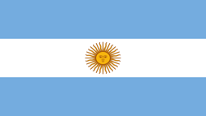
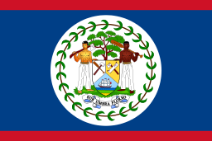

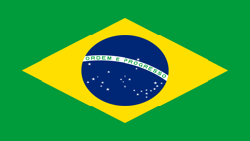

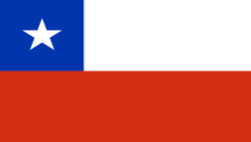
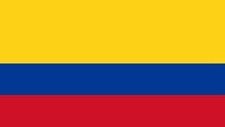
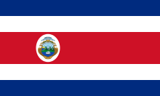
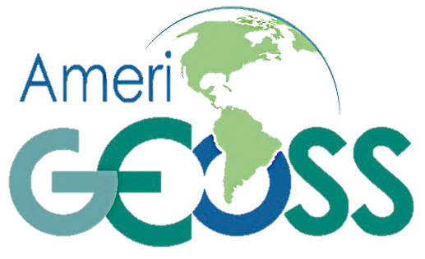
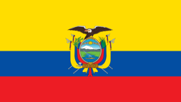
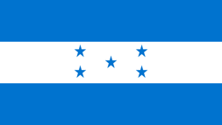
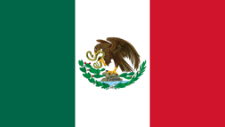
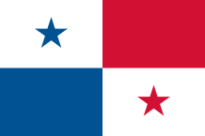
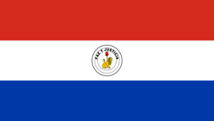
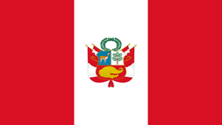


AmeriGEOSS Regional Initiative
Capacity Building to advance the use of Earth Observations
Angelica Gutierrez–NOAA, Rich Frazier–FGDC
Friday July 20, 2018
** Presenter
AmeriGEOSS.ORG
Notes:
Good Afternoon.
How is geospatial research contributing to the measurement of SDG indicators
Today I will provide an overview of AmeriGEOSS and how the community is working to strengthen the national geospatial information management capacities of countries, particularly developing countries, towards implementing the 2030 Agenda and evidence-based policy and decision making.
The AmeriGEOSS Community Platform brings together social, economic and environmental data through open data portals at the National, Regional and Global scale.

Slide 2
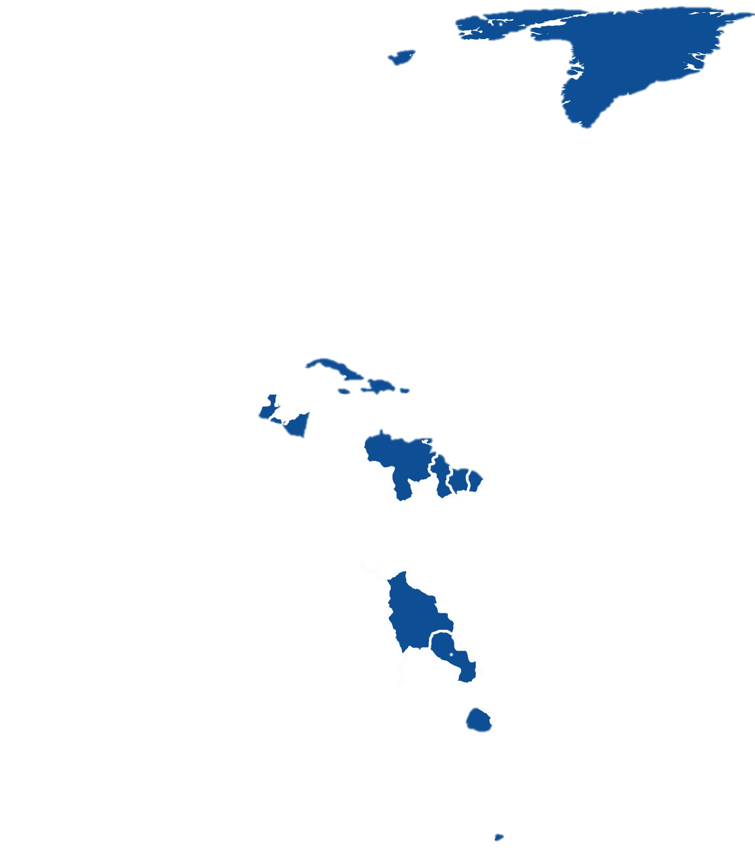
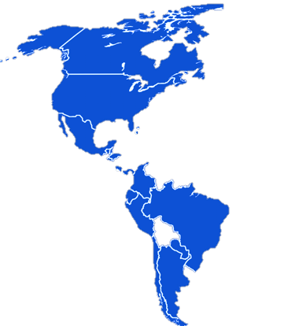
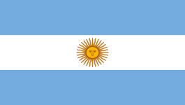
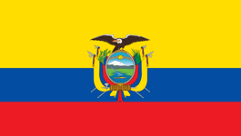
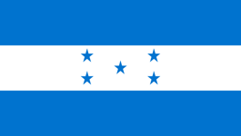



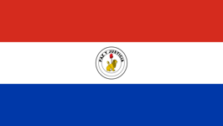


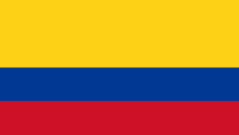


AmeriGEOSS
Initiative & Regional Coordination
Conceived in October 2014, launched in November 2015
Is a cooperative effort of the 16 GEO member countries in the Americas that:
Reflects local, national, and regional interests of the GEO country-members for short and long-term planning, development, and implementation aligned with GEO activities.
AmeriGEOSS Members
Non-AmeriGEOSS Members
Is entrenched in the institutional and technical capabilities of its country members and in the resources of other global initiatives available for the benefit of the region.
  Argentina
  Bahamas
  Belize
  Brazil
  Canada
  Chile
  Colombia
  Costa Rica
  Ecuador
  Honduras
  Mexico
  Panama
  Paraguay
  Peru
  United States
  Uruguay
Seeks to increase institutional and personal capacity and engage experts, stakeholders, and decision makers in the process of decision making.
16 Member Countries
Observers: Bolivia, Guatemala
Notes:
**Before I dive into the platform let me give you some background informaiton on AmeriGEOSS. AmeriGEOSS is an initiative under the GEO framework––launched in 2015
This is an adaptable framework that can be leveraged for capacity building.
Includes 16 nations in the Americas currently participates
Work with regional and global partners to advance the use of EO data
Develop and leverage member capacities to support stakehoder and decision-maker needs.

Slide 3
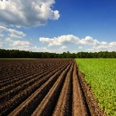
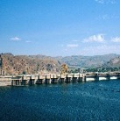
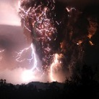
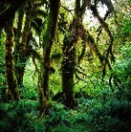





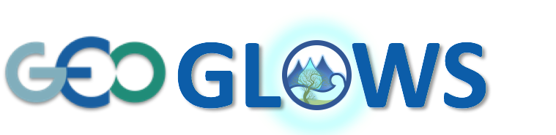
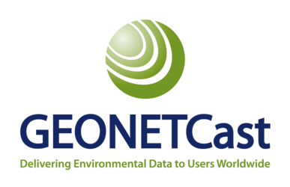




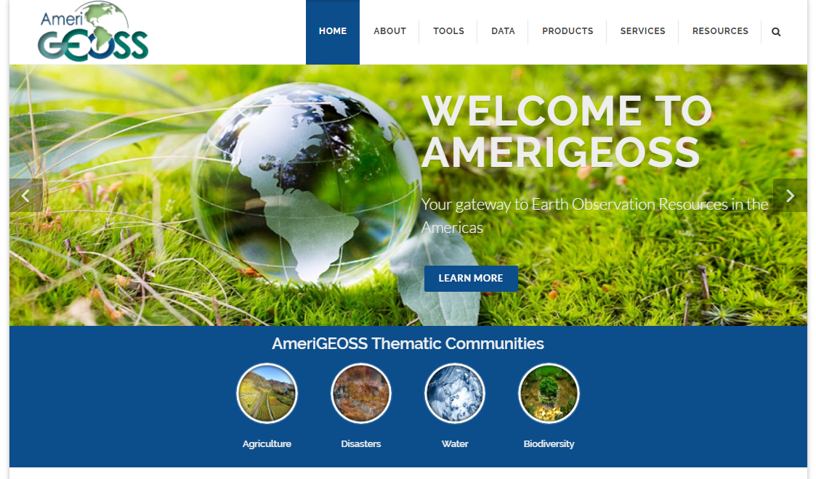


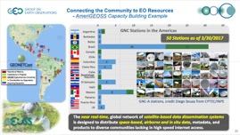



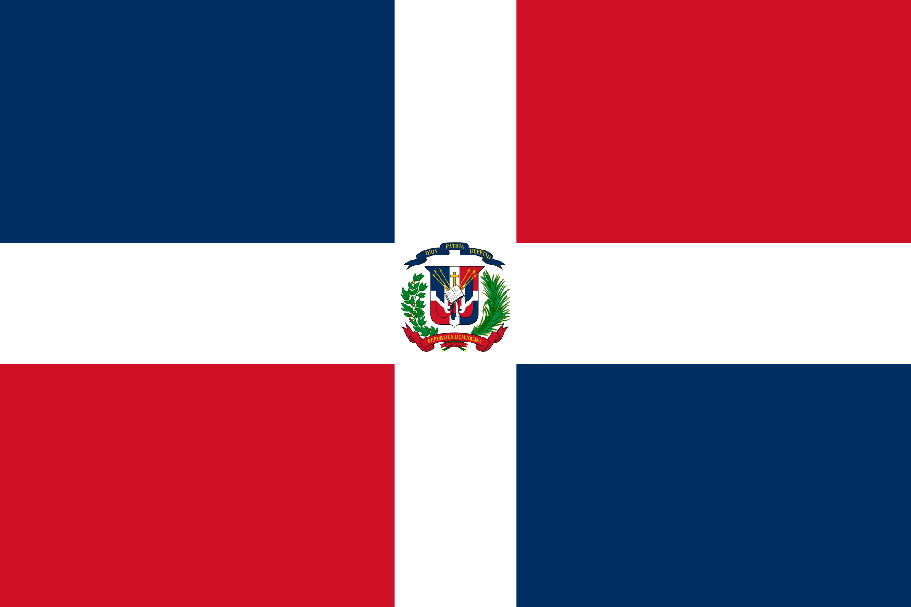
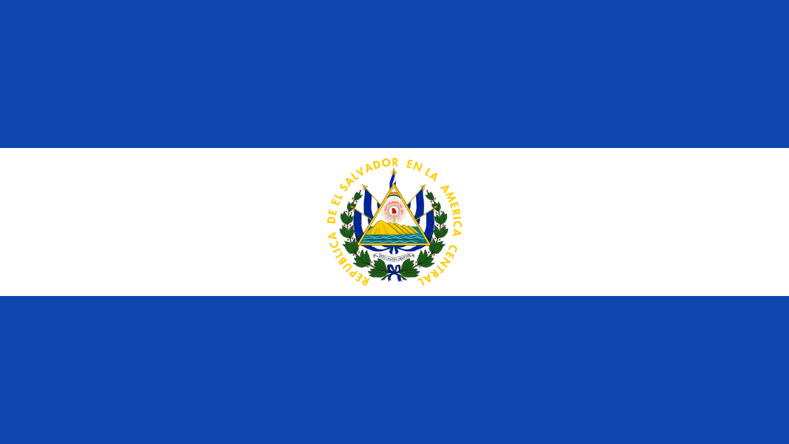
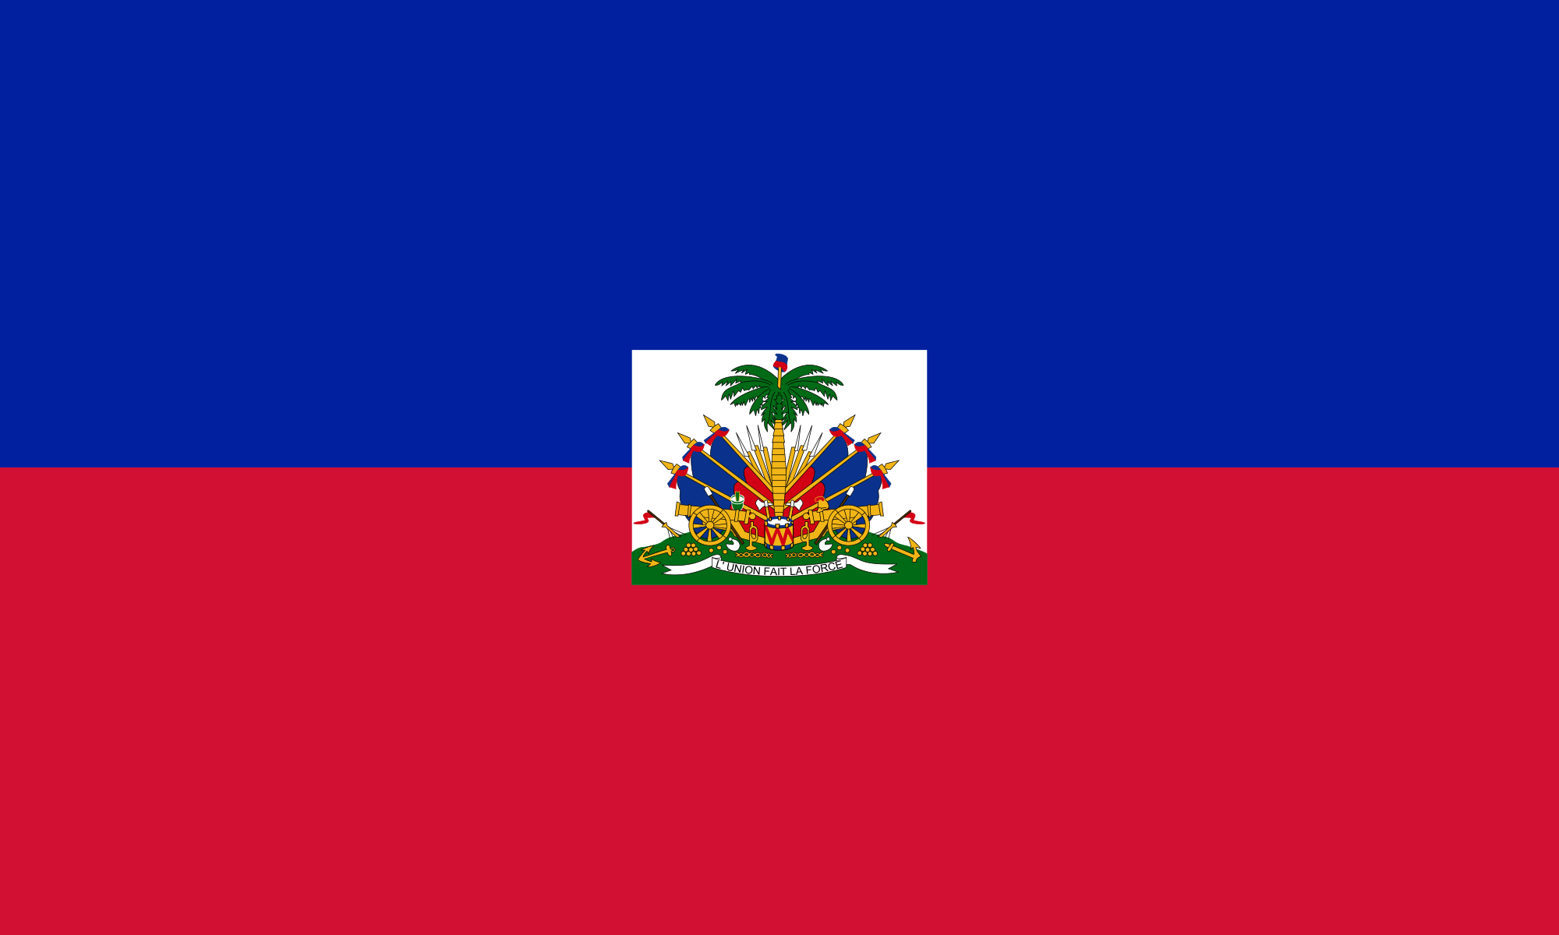
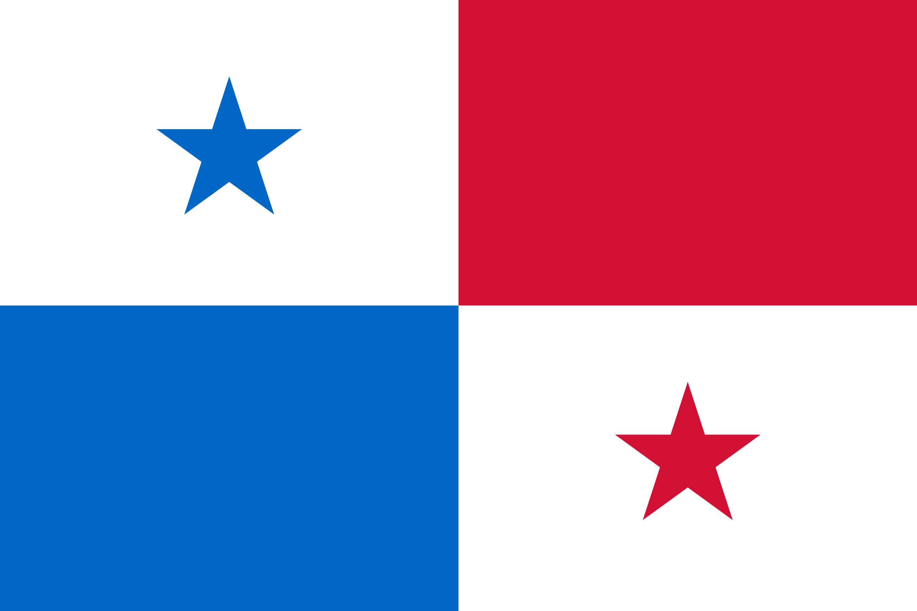
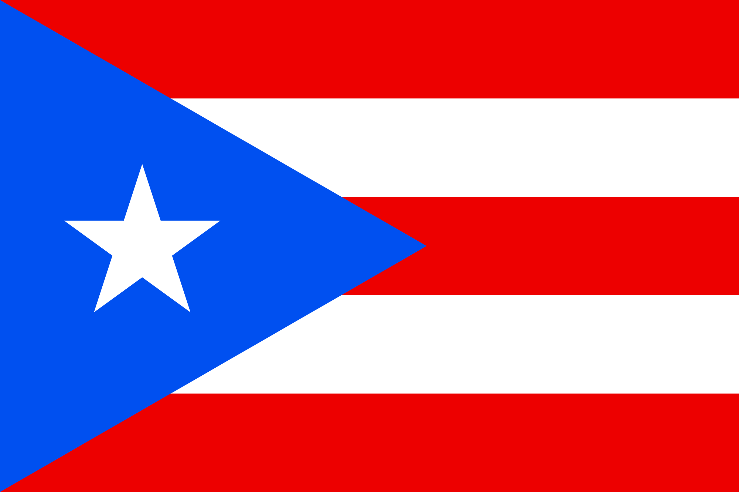
AmeriGEOSS Sample Activities
Agriculture, associated with climate variability, climate change, and food security
Water, associated with the management approach of water resources and data management
.
Disaster risk reduction, particularly for data exchange associated with early warnings & for the generation of regional products of early warnings
In the context of capacity building for better monitoring, management, and maintenance of ecosystems and biodiversity they support; and to predict future changes
Agriculture
Water
Disasters
Biodiversity & Ecosystems
Expand Crop Monitor to all countries
Increase the number of crops monitored
Launch GEOGLOWS-America
Develop Water SDG Indicators
Mobilize data and tools for Water use/stressors, availability and Quality
Establish Working Group
Flood & Landslide–Integrate Models and Monitoring
Earthquakes & Tsunamis–Expand GNSS & SAR
Volcanos–integrate SAR & LIDAR
Establish ecosystem services
Expand MBON
Bon-in-a-box
EO4SDGs
Data Mobilization
  Argentina
  Bahamas
  Belize
  Brazil
  Canada
  Chile
  Colombia
  Costa Rica
Outreach •Workshops • Training •
Infrastructure • Data • Tools • Services
  Ecuador
  Honduras
  Mexico
  Panama
  Paraguay
  Peru
  United States
  Uruguay
Capacity Building
Foundational Task
EO4SDGs
Climate Cross-Cutting
AmeriGEOSS Platform
Notes:
Agriculture – Food Security
2017 – 2025: GEOGLAM will expand its Crop Monitor activities to encompass more countries and more crops
Under GEOGLAM, investments have been made in Mexico, Brazil, and Argentina to strengthen the national capacity to utilize remote sensing-based methodologies. In 2017 we expect to engage Colombia and Chile with two pilot projects targeting tropical agricultural crops.
Water –
GEONETCast is a foundational activity of AmeriGEOSS with a strong hydro-met user community in the region with systems in the following ten (10) countries: USA, Mexico, Brazil, Costa Rica, El Salvador, Barbados, Puerto Rico, Colombia, Argentina, and Chile.
16 countries total contribute
This user-driven, user-friendly and low-cost information dissemination service aims to provide global information as a basis for sound decision-making in a number of critical areas, including public health, energy, agriculture, weather, water, climate, natural disasters and eco-systems

Slide 4
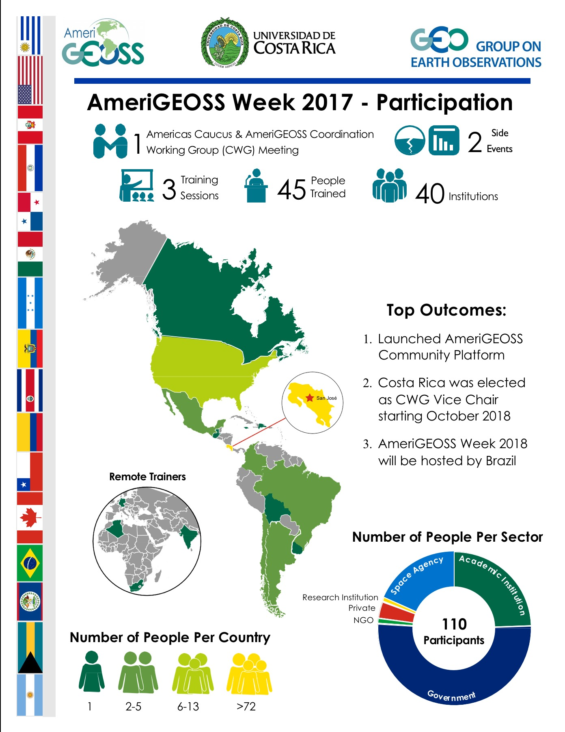
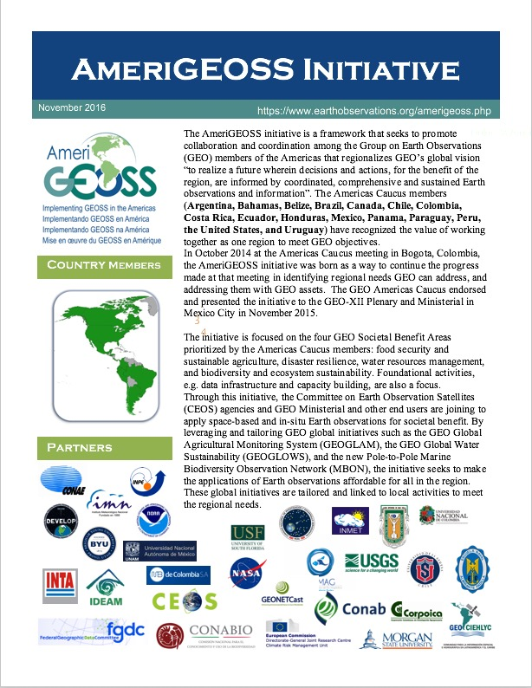
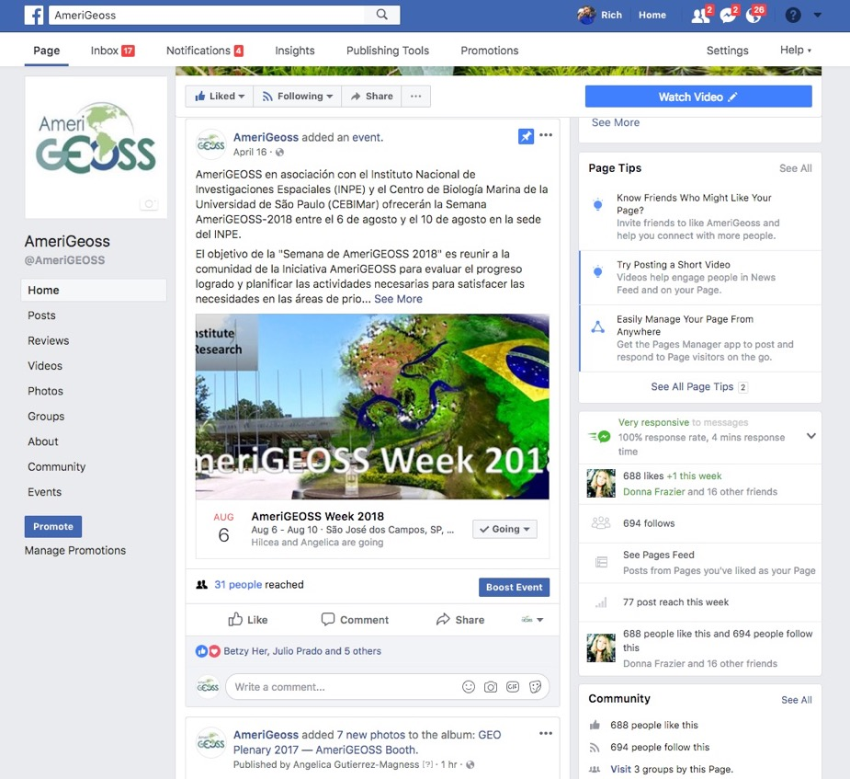

AmeriGEOSS / Capacity Building
Communication, Outreach, Training and Development
Advocate
Engage

Slide 5
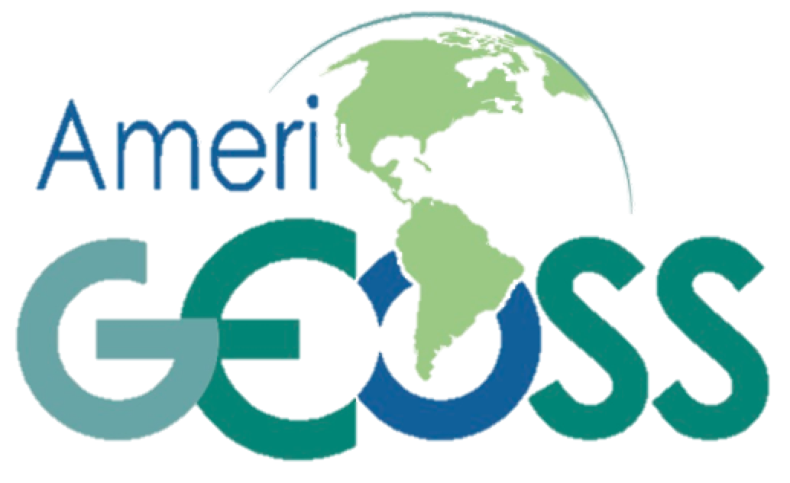
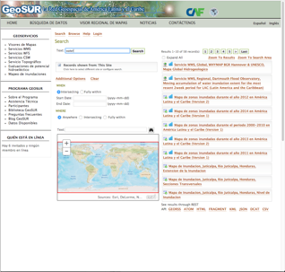
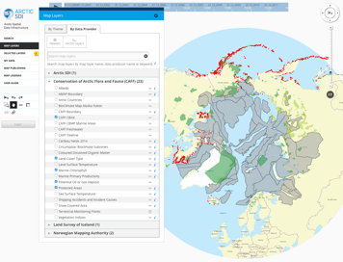
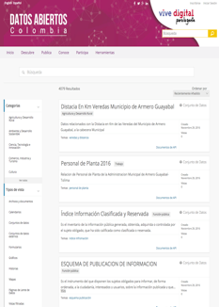



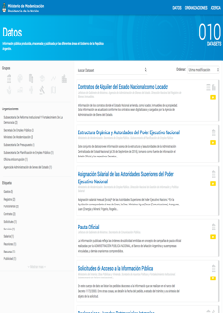
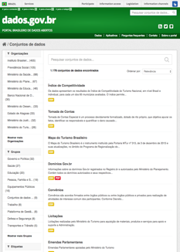
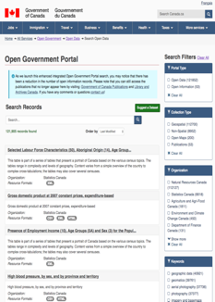
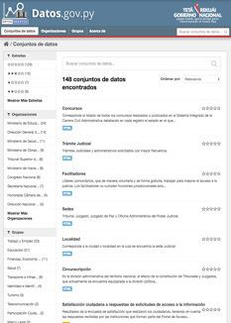



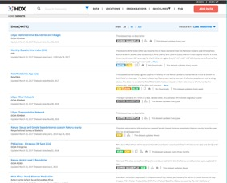
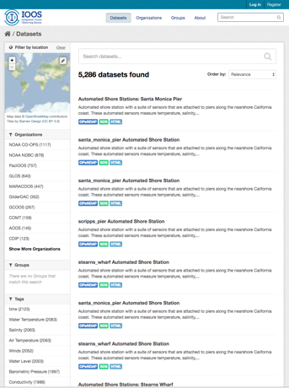
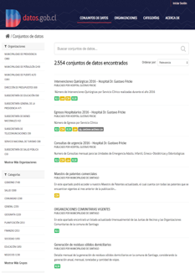
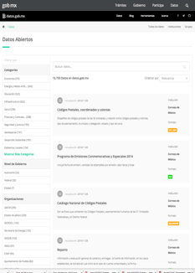
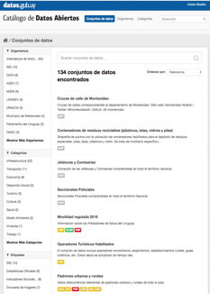
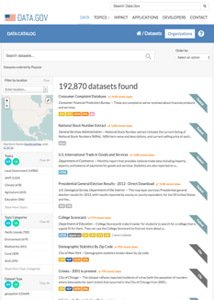




AmeriGEOSS Community Platform
1
The platform bringing together social, economic and environmental data through open data portals at the National, Regional and Global scale.
3
Regional
Ameri
Data
2
National
Tools
4
Global
Products
Services
Resources
Community Platform
Notes:
Through the Open Government Partnerships and Open Data standards, the platform mobilizes data, tools, products and services from our national, regional, and global providers. It provides access to national, regional and global resources.
Many people ask – “Why Another Portal?”
Not just another geospatial portal –it’s an exploitation Platform!!! The AmeriGEOSS Community Platform brings together social, economic and environmental data for understanding and decision-making and supports harmonization and co-creation of products and services.
The platform allows authorized user to curate content and create specialized views of the resources that can be shared with others
The platform provides inline tools for visualization and analysis. You no longer need to download and try to use the data in other specialized software packages
The platform leverages National open data resources, regional, and global capabilities. Most of the resources in the platform are directly harvested from open data portals from the participating countries. It also harvests from regional initiatives like GEOSUR and the Arctic SDI, and global resources such as the UN Humanitarian Data Exchange
I will now show you some of these features that showcase these exploitation features!

Slide 6
AmeriGEOSS Open Data Progress Report
Community Platform
10
As of 04/20/2017
Notes:
Argentina - http://www.datos.gob.ar/dataset
Brazil - http://dados.gov.br/dataset
Canada - http://open.canada.ca/data/en/dataset
Chile - http://datos.gob.cl/
Columbia - https://www.datos.gov.co/
Costa Rica - http://datosabiertos.presidencia.go.cr/search/?q=&x=0&y=0
Ecuador - http://catalogo.datosabiertos.gob.ec/
Honduras
Mexico - https://datos.gob.mx/busca/dataset
Paraguay - https://www.datos.gov.py/dataset
United States - https://catalog.data.gov/dataset
Uruguay - https://catalogodatos.gub.uy/dataset

Slide 7


















AmeriGEOSS Data-Hub
– Data Catalog and Capabilities
About AmeriGEOSS Initiatives | Data | Tools | Products | Services | Resources |
Search
- Text¹, Faceted² and Spatial Search³
1
3
Find
- Resources in many Formats⁴
4
Use
- Multi-platform support⁵
2
5
Notes:
The platform provides a variety of methods to search for data, find data in various formats and use the resources from a variety of platforms and devices. The AmeriGEOSS Data-Hub uses the CKAN open source platform to provide access to and link resources in the region.
The search tools allow the user to search and discover resources through several methods:
Keyword text search
Faceted search
Spatial search
Formats - Formats can be searched in the faceted search tool. The search results also presents the available formats so users can more easily find the exact resources they need.
The platform operates on many platforms including desktops, tablets and phones for our user community.

Slide 8























AmeriGEOSS Data-Hub
– Analytical Tools to Support Understanding
About AmeriGEOSS Initiatives | Data | Tools | Products | Services | Resources |
Carlos Maia
Luis Miguel
3
View Reports and Dashboards
PDF
TXT
PNG
PDF
XLS
CSV
RTF
DOC
HTML
GIF
XLS
1
Interact With Data
4
2
Create Graphs, Charts, Maps and More
WMS
WFS
WMTS
GeoJSON
GML
KML
ArcGIS Rest API
GFT
5
Notes:
The platform provides a variety of methods to search for data, find data in various formats and interact the resources from a variety of platforms and devices. This is one of the most powerful components of the AmeriGEOSS Community Platform. It expands beyond other search-discovery platforms to provide a search-discovery-visualization-exploitation platform!
Users can interact with data and documents. These screenshots demonstrate how the user can discover and interactive with:
Tabular data from Brazil. This query tool allows for sorting, querying and graphing
2) Users can create graphs, charts, maps and more
Map data from Colombia
After a user discovers resources that are of use, they can view reports and dashboards.
Dashboards are collections of related resources grouped together for sharing and collaboration

Slide 9









Implementing SDGs: Geographic Value
Geographic Information––A Universal Framework for Linking Social, Economic and Environmental data
Social
Data
Tools
💰
💶
Services
Economic
Environmental
Greg Scott & Abbas Rajabifard http://orcid.org/0000-0002-4256-3173
Notes:
One of the strategic objectives of AmeriGEOSS is to provide capacity to use EO resources in decision-making.
The platform is being developed to bring together social, economic and environmental data to support understanding and decision-making around a variety of topics

Slide 10










AmeriGEOSS Data-Hub Capabilities
About AmeriGEOSS Initiatives | Data | Tools | Products | Services | Resources |
Tools and Resources from
Global Providers in one Place
1
Find Data
2
Tools
3
Imagery
Notes:
We are now in the use case development phase working with the community to leverage the platform around societal issues such as food security.
Using the platform the community can access a variety of social, economic and environmental resources from providers to understand causes and develop knowledge based products and services to model, forecast and respond. The platform allows user to find and use tools and resources from our global providers without leaving the platform.
We have been working with the Food Security community to showcase the available resources and platform tools that they can utilize.
Find Data - In this example, I used the platform to search for agriculture resources. The platform found 165 results.
Tools – One of the search results found the GEOCLAM (Global Agricultural Monitoring Initiative. GEOCLAM strengthens global agricultural monitoring by improving the use of remote sensing tools for crop production projections and weather forecasting. Users can directly access the GeoCLAM tool from the platform.
Imagery - One of the search results is the Famine Early Warning Systems (FEWS.Net) website. This website provides access to geospatial and satellite imagery products in support of FEWS drought monitoring efforts throughout the world. The platform embeds this website directly in the platform providing direct access to their data, products, tools and services.

Slide 11











AmeriGEOSS Data-Hub Capabilities
About AmeriGEOSS Initiatives | Data | Tools | Products | Services | Resources |
Explore Social, Economic and Environmental , Reports, Information, Indicators…..and More
Find Water Data
1
Water Variables
2
3
Water Reports & Indicators
4
Use maps, applications and other analytical tools
CEOS Water Portal
Notes:
One of our community initiatives is GEOGlows. We are initiating efforts to support capacity building to understand water use, water availability, and water quality. The outcomes of these activities will support clean water and sanitation efforts under SDG 6.
[CLICK] - Through the platform a researcher or analyst can find water data
- In this example, I search on aqua and the matching results were provided to me
[CLICK] - Access a variety of hydrometric data to understand variables and
- Using the faceted search tools in the left side panel, I can filter through the results according to the water variables that meet my exact needs
3) [CLICK] - After completing searches, the user can access reports, community developed maps, applications and analytical tools to support understanding and decision-making.

Slide 12






AmeriGEOSS Data-Hub Capabilities
About AmeriGEOSS Initiatives | Data | Tools | Products | Services | Resources |
Find Disaster Data
Explore Disaster Tools and Resources
Fire Information Resource Management System
Use maps, applications and other analytical tools
Near Real-Time (NRT) active fire data
Notes:
One of our focus area is providing access to Disaster data through the platform.
In this example, I searched for disaster data and 368 results were returned.
One example is from the NASA Fire Information for Resource Management System (FIRMS). FIRMS distributes Near Real-Time (NRT) active fire data within 3 hours of satellite overpass from both the Moderate Resolution Imaging Spectroradiometer (MODIS) and the Visible Infrared Imaging Radiometer Suite (VIIRS).
Since this resource was added to the platform as a WMS service, an interactive map viewer displays the real time data from the last 24 hours. The user can pan and zoom to their geographic area of interest for more detailed information.

Slide 13






















AmeriGEOSS / Capacity Building – Use Cases
Economic
Societal
Environment
Communities of Practice
Training & Education
Essential Variables & Indicators
Pilots and Use Cases

Slide 14




Imagery Analytics – Build Capacity in the Region to use Imagery as a resource in Decision Making
Domo Planas
How has the environment changed 1997 – 2017?
Notes:
The AmeriGEOSS community acknowledges that imagery is a powerful resource that can improve understanding and decision-making. We are developing a tool that will allow novice and advanced users to leverage imagery for improve understanding and decision making.

Slide 15







Change Detection Jan 2000 – Oct 2017
AmeriGEOSS Imagery Analysis Tool - Transforming Earth Observations into Actionable Information
AmeriGEOSS Imagery Analysis Tool
Sample Imagery Layers
Geology
Access imagery on demand
Integrate other data and services
Conduct analysis
  Compare Imagery
  Detect Change
  And More
Bathametric
Agriculture
Water
AmeriGEOSS Imagery Analysis Tool (Beta)
Vegetation
Choose Layers and Data
Select Active & Compare Layers
Image Selector
Render and Compare
Notes:
The imagery analysis tool can be used to visualize imagery, combine other data for analysis, measure, compare and detect change over time.

Slide 16





1
Example #1 : Detecting change in Vegetation using imagery (Illustration Only)
Visualize
Analyze
Detect Change
Normalized Difference Vegetation Index colorized maps.
Jul 1997 – Jul 2002
Jul 2002 – Jul 2007
Thick Vegetation Sparse Vegetation
Dark green is thick vigorous vegetation & brown represents sparse vegetation.
Jul 2007 – Jul 2012
Jul 2012 – Jul 2017
This service includes scenes from Landsat 8 and Global Land Survey (GLS) data
Notes:
The imagery analysis tool can be used to visualize imagery, combine other data for analysis, measure, compare and detect change over time.

Slide 17

1
Example #1 : Detecting change in Vegetation using imagery (Illustration Only)
Thick Vegetation Sparse Vegetation
Visualize
Analyze
Detect Change
2002
Normalized Difference Vegetation Index colorized maps.
2012
Dark green is thick vigorous vegetation & brown represents sparse vegetation.
2017
Significant Change
This service includes scenes from Landsat 8 and Global Land Survey (GLS) data
Notes:
This is a an example using imagery to visualize the change in vegetation over time. This time based example shows areas of environmental stress from 1997 through 2017 in 5 year increments. As you can see in this illustration there are a number of areas that indicate a decrease in vegetation.

Slide 18





2
Example #2 : Detecting change in Moisture using imagery (Illustration Only)
Visualize
Analyze
Detect Change
Normalized Difference Moisture Index colorized maps.
Jul 1997 – Jul 2002
Jul 2002 – Jul 2007
Wet Areas Dry Areas
Wetlands & moist areas are blues, and dry areas in deep yellow & Brown
Jul 2007 – Jul 2012
Jul 2012 – Jul 2017
This service includes scenes from Landsat 8 and Global Land Survey (GLS) data
Notes:
This is another example using the tool to determine moisture in the same area.

Slide 19

2
Example #2 : Detecting change in Moisture using imagery (Illustration Only)
Visualize
Analyze
Detect Change
Wet Areas Dry Areas
Normalized Difference Moisture Index colorized maps.
Wetlands & moist areas are blues, and dry areas in deep yellow & Brown
Significant Change
This service includes scenes from Landsat 8 and Global Land Survey (GLS) data
Notes:
This is a an example using imagery to visualize the change in moisture over time. This time based example shows areas of environmental stress from 1997 through 2017 in 5 year increments. Note the correlation between vegetation loss and moisture loss.

Slide 20






3
Example #3 : Detecting change in Vegetation––January 1997 – Oct 2017 using imagery (Illustration Only)
Sample Imagery Jan 2000 – Oct 2017
Change Detection Jan 2000 – Oct 2017
October
2017
January
2015
January
2009
April
2006
January
2000
Increased Decreased
Areas that show up green increased in brightness, areas that show up in magenta decreased in brightness, while area in gray no change.
Significant Change
Test the tool

Slide 21
AmeriGEOSS / World Bank Collaboration Opportunities
Add World Bank Data : Integrate the world bank data into the AmeriGEOSS platform for use by countries
Workshops : Workshops to train users to leverage the AmeriGEOSS platform and world bankd data to support world bank projects
Pilots and Prototypes : Use cases to demonstrate the integration of world bank data, earth observations and other open data from countries in the Americas (Examples)
  Water assessments by country
  Famine early warning
  Disaster planning, response and recovery
  Development of tools that support environmental indicator monitoring and forecasting

Slide 22

Conclusion: AmeriGEOSS Platform––Transform Earth Observations into Actionable Information
AmeriGEOSS is building capacity in the region to use Earth Observation as a resource in decisionmaking
Geology
Bathametric
Questions?
Agriculture
Water
Vegetation
AmeriGEOSS.ORG
Notes:
Good Afternoon.
How is geospatial research contributing to the measurement of SDG indicators
Today I will provide an overview of AmeriGEOSS and how the community is working to strengthen the national geospatial information management capacities of countries, particularly developing countries, towards implementing the 2030 Agenda and evidence-based policy and decision making.
The AmeriGEOSS Community Platform brings together social, economic and environmental data through open data portals at the National, Regional and Global scale.

Slide 23




AmeriGEOSS for SDG’s
Exploitation Platform
Sustainable Development Goals: Discover Economic, Social, Environmental and other resources.
Economic
Societal
Environment
Communities of Practice
Training & Education
Essential Variables & Indicators
Pilots and Use Cases
Notes:
AmeriGEOSS has participated with GEO in SDG Efforts
The AmeriGEOSS exploitation platform established in 2017 was designed to bring together communities of practice to use big data tools and services to support societal goals and objectives in the Americas.
The platform provides a variety of data and analytical capabilities
We are currently building capacity in the Americas around EV’s & indicators and to develop pilots and use cases.
Efforts under GEO’s SDG initiative and GeoGlam demonstrated how Satellite, Academic, Crowdsourced and other information can support SDG 2 Zero Hunger indicators
Similarly SDG work under SDG 6 to monitor water availability and use are

