Slide 1
SPATIAL ENABLEMENT
IN SMART HOMELAND
SMART DISASTER PREVENTION SMART TRANSPORTATION SMART CITY
US National Spatial Data Infrastructure
A Spatial Framework for Governance and
Policy Development to Enable Smart Location-Based Digital Ecosystems
Ivan DeLoatch
Executive Director
Federal Geographic Data Committee

Slide 2
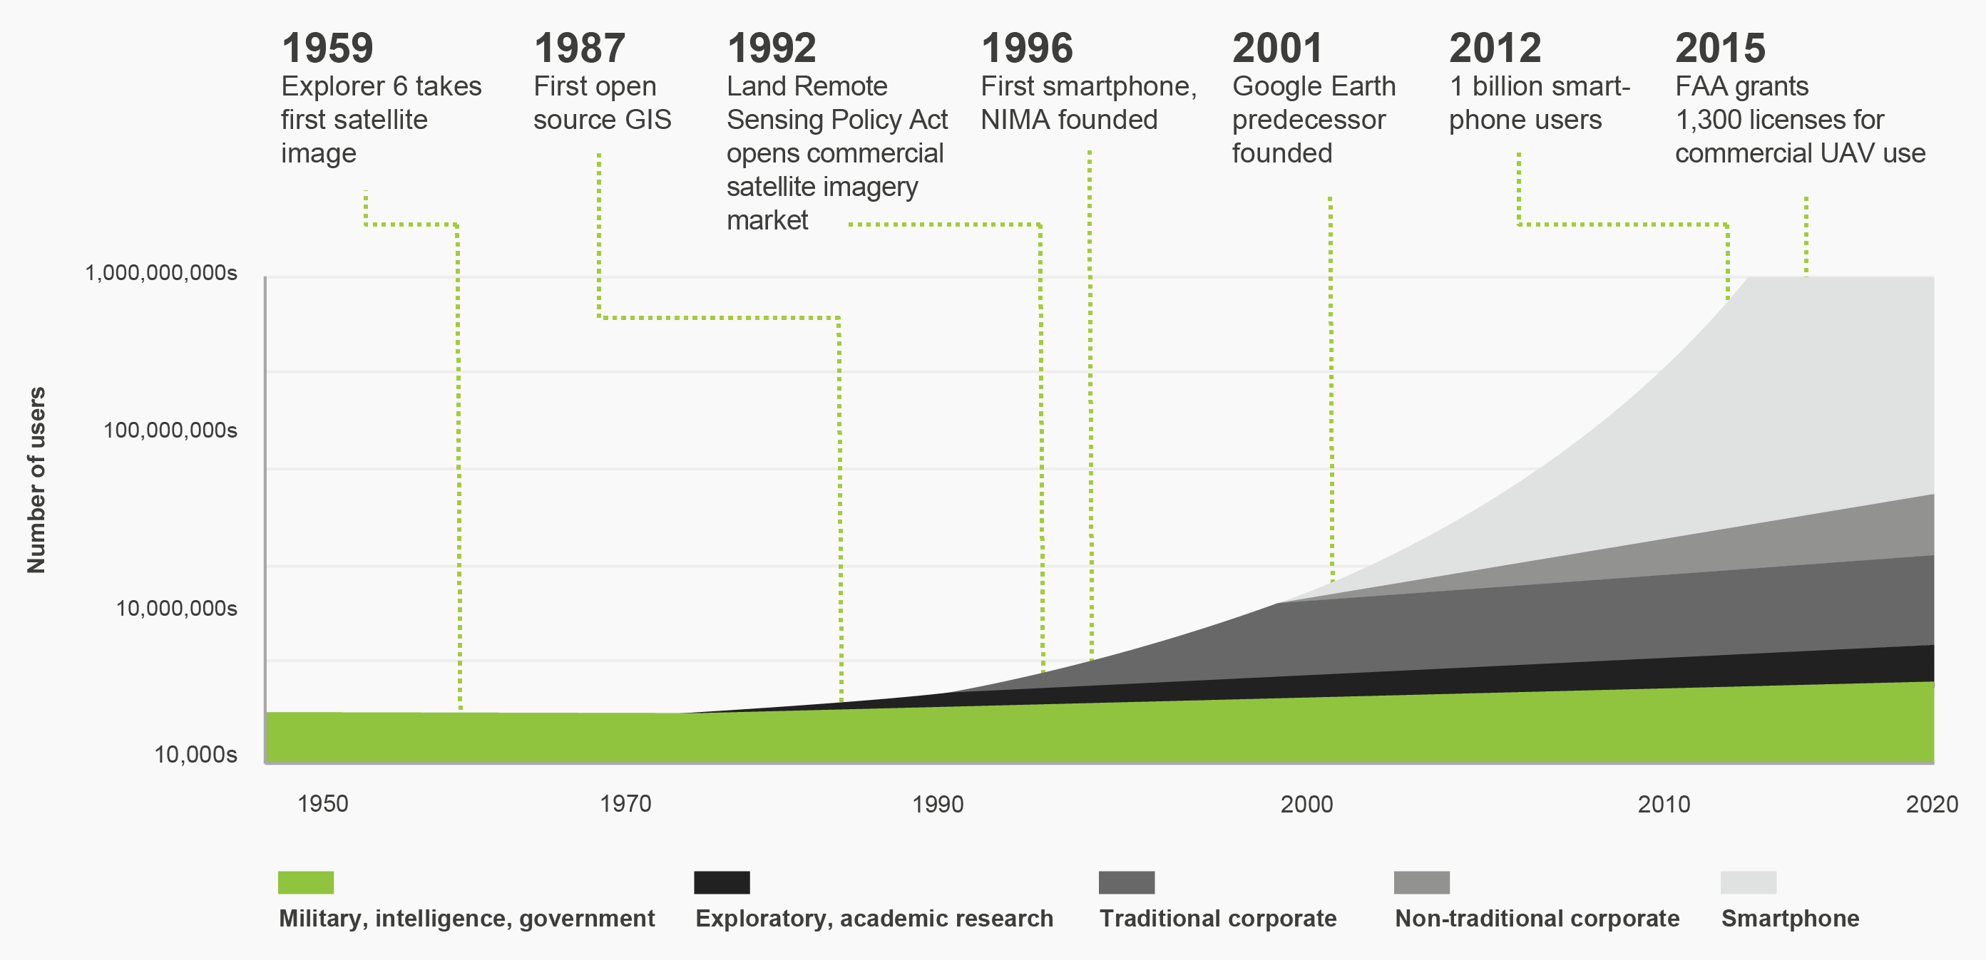
A Spatial Framework for the Location-Based Digital Ecosystem
Growth of Geospatial Services
Geospatial information and technologies use has increased exponentially, driven primarily by the proliferation of mobile devices needing location information

Slide 3
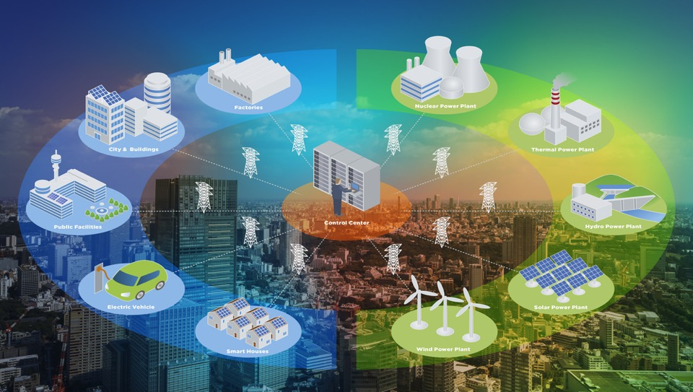
A Spatial Framework for the Location-Based Digital Ecosystem
The Future–Connected Smart Communities
Smart Factories
Smart Grid
Drones deliver packages and conduct surveillance
Mobile devices alert users to closest services
Homes detect occupants and weather to adjust connected devices (Temperature, Security, Power etc.)
Government agencies make policy decisions based on dynamic and timely geospatial data
Transportation monitors 3-D environment and road conditions to provide autonomous driving
Information from mobile sensors will be aggregated and enhanced to power location-based decisions
Smart Cities
Smart Environment
Location-Based
Digital Ecosystem
Smart Facilities
Smart Utilities
Internet of Things
Smart Transportation
Smart Delivery
Smart Health
Smart Houses

Slide 4
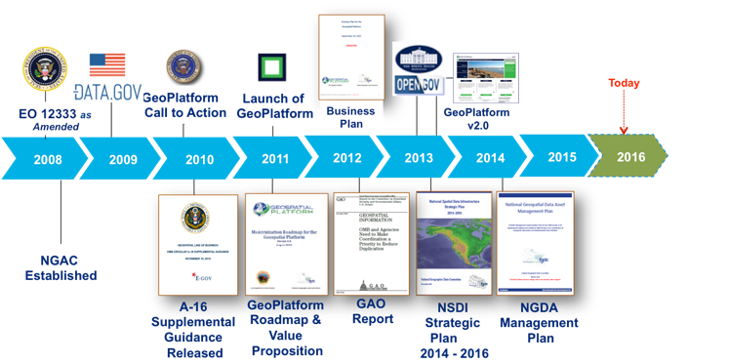
A Spatial Framework for the Location-Based Digital Ecosystem
Our Journey Advancing the Location-Based Digital Ecosystem
1990
The United States Federal Geographic Data Committee (FGDC) was Established in 1990 to Coordinate the Nations Geographic Information and Federal Spatial Data Activities

Slide 5
A Spatial Framework for the Location-Based Digital Ecosystem
How do we enable
Location-Based Digital Ecosystems for Smart Communities?
Partnerships
Policies
NSDI Framework for Advancing the Location-Based Digital Ecosystem
Standards
Procedures
Data
Technology
National Spatial Data Infrastructure

Slide 6
A Spatial Framework for the Location-Based Digital Ecosystem
Components to enable Location-Based Smart Communities
Data
Discoverable, Accessible
Usable
People
Public-Private
Partnerships
Technology
Tools, Applications
& Services
Policy
Governance
Standards
Procedures

Slide 7
A Spatial Framework for the Location-Based Digital Ecosystem
How do we enable a Location-Based Digital Ecosystem?
People: Collaboration, Cooperation, Cultivation
People
Public-Private
Partnerships
Data
Technology
Policy
Governance
Standards
Procedures
Workforce
Development
Cooperation
Collaboration
Public
Engagement
Public
Participation
Workforce
Development

Slide 8
A Spatial Framework for the Location-Based Digital Ecosystem
NSDI Partnerships & Collaboration
Federal
Public-Private
Partnerships
State & Local
Tribal
Private & Professional
Academia
International

Slide 9
A Spatial Framework for the Location-Based Digital Ecosystem
Partnerships and Governance
STEERING COMMITTEE
EXECUTIVE COMMITTEE
NATIONAL GEOSPATIAL ADVISORY COMMITTEE
OFFICE OF THE SECRETARIAT
COORDINATION GROUP
Public-Private
Partnerships
Strategic Direction
THEMATIC SUBCOMMITTEES
Address
Cadastre
Non-Federal Advisory
Cultural Resources
3D Nation Elevation
Geodetic Control
Geologic Data
Homeland Infrastructure Foundation –Level Data
Federal Advisory
Marine and Coastal Spatial Data
National Digital Orthimagery Program
Spatial Water Data
Transportation
Address Specific Geospatial Issues
Vegetation
Wetlands
UN Global Geospatial Information Management
Users
/Historical Data
Metadata
Standards
Architecture & Technology
National Boundaries
CROSSCUTTING WORKING GROUPS
FOUNDATIONAL COMPONENTS
PARTNERSHIPS
POLICIES
PROCEDURES
STANDARDS
DATA
TECHNOLOGY
National Spatial Data Infrastructure
Advancing Geospatial Capabilities for the Nation

Slide 10
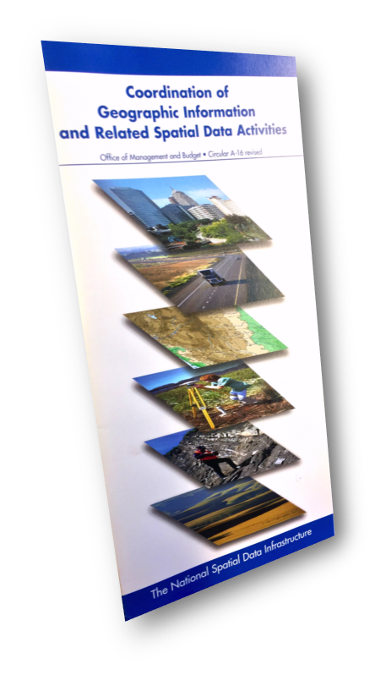
A Spatial Framework for the Location-Based Digital Ecosystem
Policy
Governance
Policy and Procedures
Public Laws
Executive Memos
Circulars
Reference Guides

Slide 11
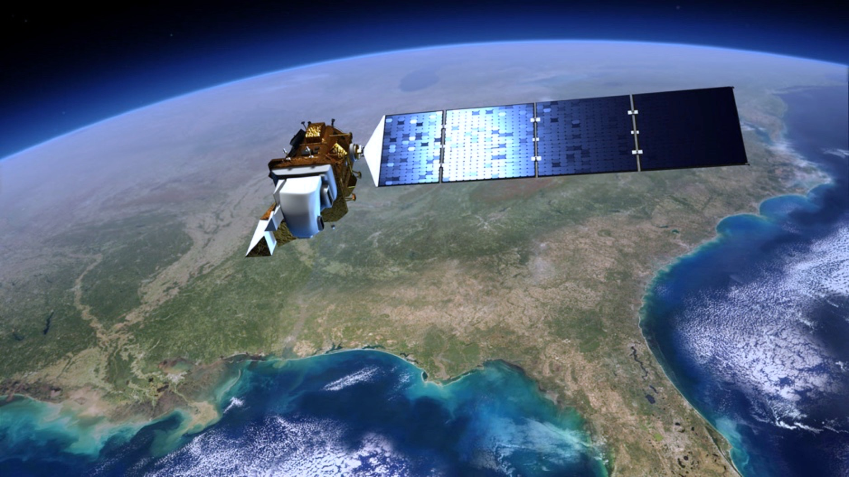
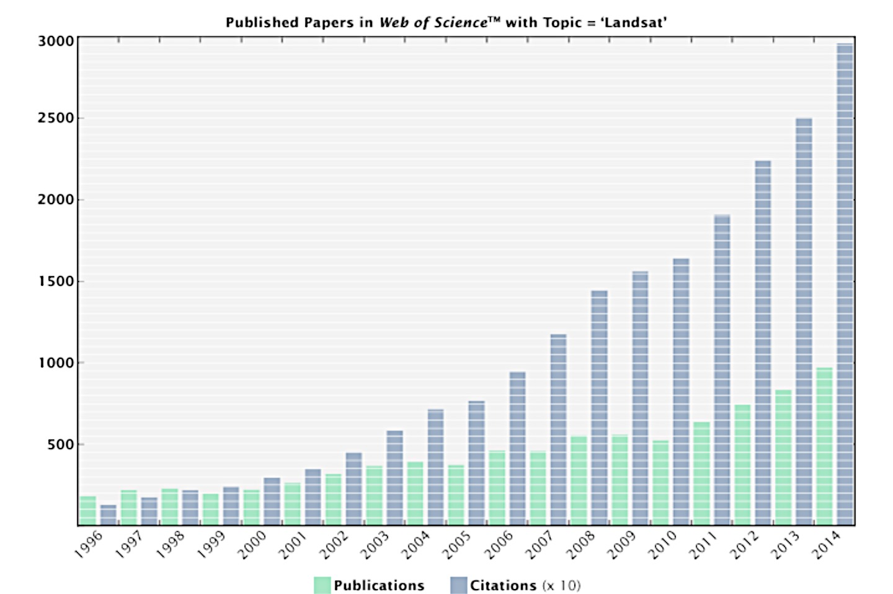
A Spatial Framework for the Location-Based Digital Ecosystem
Open Data Policy Impact on Landsat Services
Policy
Governance
Annual Economic Benefit
USA $1.70 B
International $400 M
Global Total $2.1 B
.
25,000,000
20,000,000
15,000,000
10,000,000
5,000,000
After Open-Data Policy:
5,700 scenes/day
Free and Open Data
Before Open Government:
53 scenes/day
Downloads

Slide 12
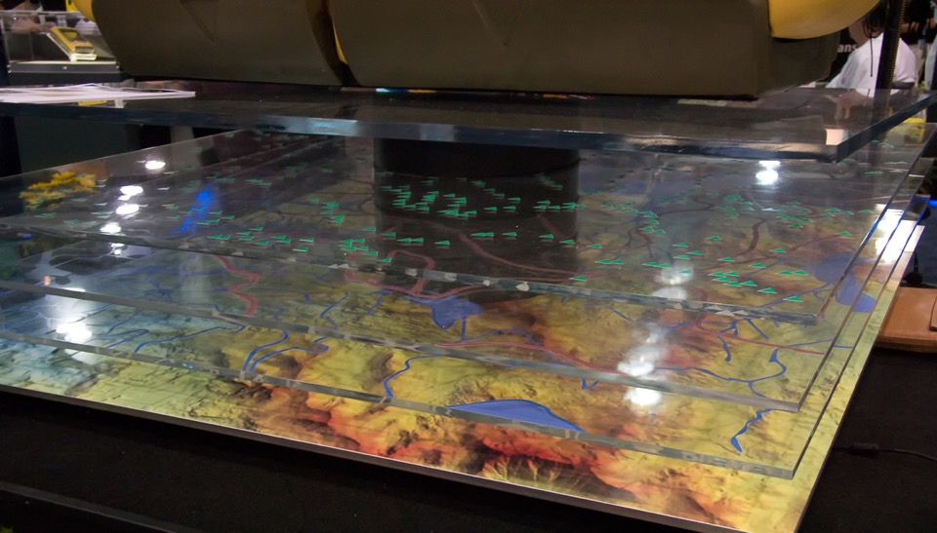
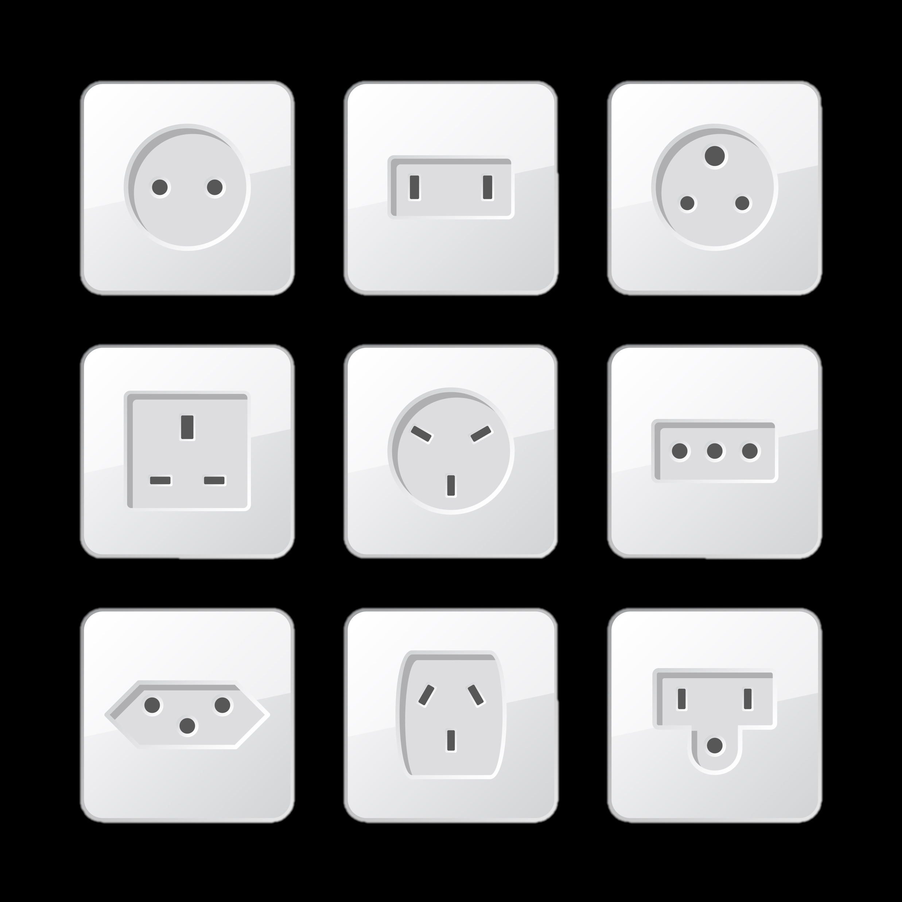
A Spatial Framework for the Location-Based Digital Ecosystem
Standards
Procedures
Standards & Interoperability
Standards facilitate development, sharing, and use of geospatial data and services
1
2
3
4
5
Develop Proposal
Review
Proposal
Setup Project
Produce Working Draft
Review Working Draft
Proposal
Project
Draft
Standards Working Group
Subcommittee/Working Group
Standards Development Group
Subcommittee/Working Group
6
7
Review
10
11
8
9
Review & Evaluate Committee Draft
Approve Standard for Public Review
Coordinate Public Review
Respond to Public Review
Evaluate Responsiveness to Public Comments
Approve Standard for Endorsement
Approve Standard for Endorsement
Final
Standards Working Group
Coordination Group
FGDC Secretariat
Standards Development Group
Standards Working Group
Coordination Group
FGDC Steering Committee
Notes:
Standards facilitate development, sharing, and use of geospatial data and services. The FGDC develops or adopts geospatial standards for implementing the NSDI, in consultation and cooperation with State, local, and tribal governments, the private sector and academic community, and to the extent feasible, the international community. The FGDC Standards component process is:
Collaborative (inclusive of Public and Private Partners)
Structured
Iterative
And well-documented as you can see on this process diagram.
The FGDC standards development process is modeled after the ISO and the American National Standards Institute standards processes
Federal agencies that collect, use, or disseminate geographic information and/or carry out related spatial data activities are required to follow FGDC standards
Non-Federal agencies are encouraged to use FGDC-endorsed standards to facilitate data sharing.
The FGDC has established and endorsed over 100 meta-data, data, technology and other national and international standards.

Slide 13
A Spatial Framework for the Location-Based Digital Ecosystem
How do we enable a Location-Based Digital Ecosystem?
Data : As a National Asset
Data
Discoverable, Accessible,
Usable
People
Technology
& Services
Policy
Governance
Standards
Procedures
Open Data
Meta Data
Linked Data
Harmonized
Data
Managed Data
Actionable
Data

Slide 14
A Spatial Framework for the Location-Based Digital Ecosystem
Data Framework
Data
Discoverable, Accessible,
Usable

Slide 15
A Spatial Framework for the Location-Based Digital Ecosystem
NSDI Framework Data
Data
Discoverable, Accessible,
Usable

Slide 16
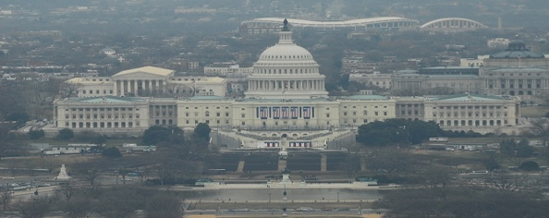
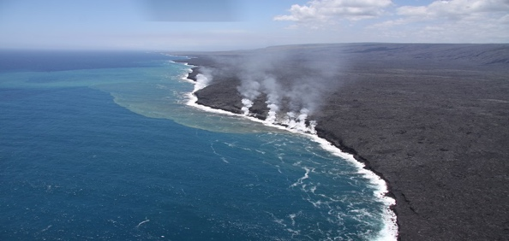
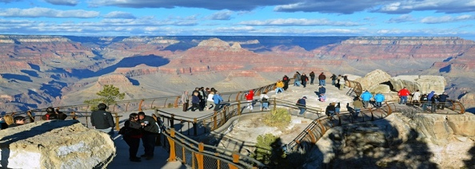
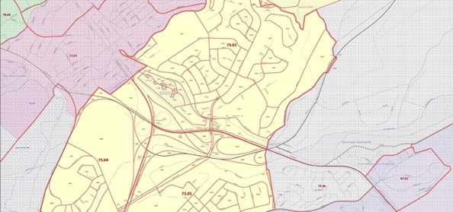
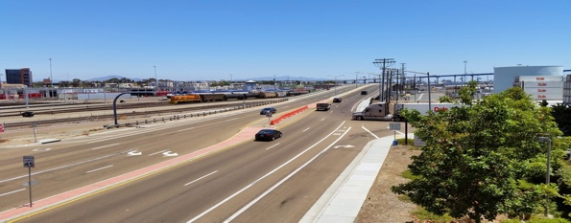
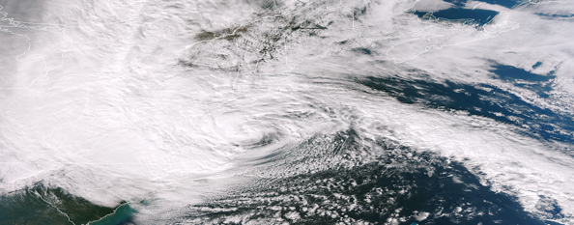
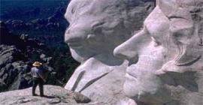
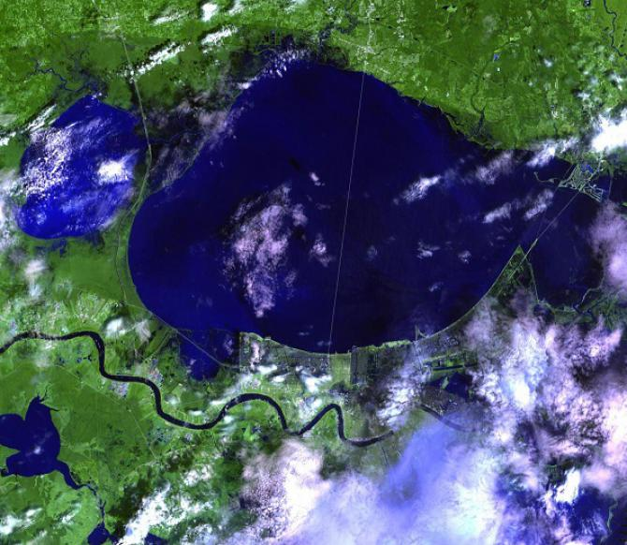
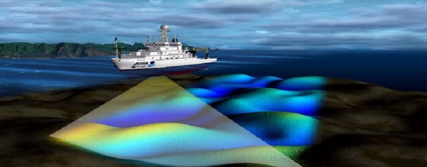
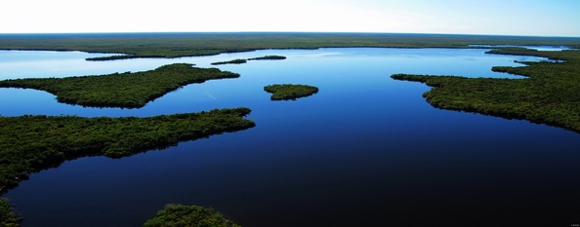
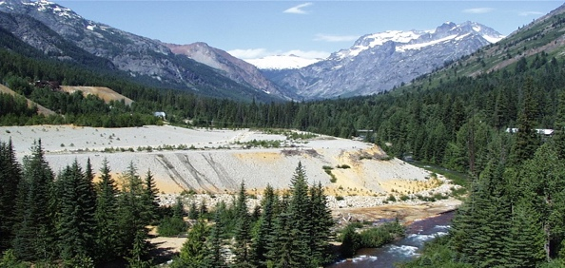
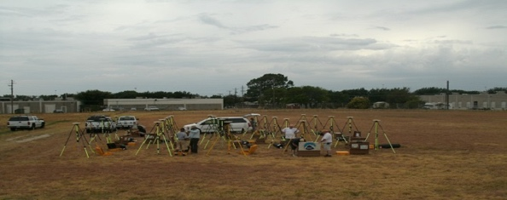
A Spatial Framework for the Location-Based Digital Ecosystem
National Geospatial Data Assets Data Themes
Biodiversity & Ecosystems
Real Property
Geology
Cadastre
Soils
Government Units
Climate & Weather
Transportation
Cultural Resources
Imagery
Utilities
Elevation
Water-Inland
Land Use & Land Cover
Data
Discoverable, Accessible,
Usable
Geodetic Control
Water – Oceans & Coasts

Slide 17
A Spatial Framework for the Location-Based Digital Ecosystem
How do we enable a Location-Based Digital Ecosystem?
Technology : Providing data, tools and services
Technology
Tools, Applications
& Services
People
Data
Policy
Governance
Standards
Procedures
Emerging
Technologies
Shared
Services
Cloud
Internet
Of Things
Autonomous
Vehicles
Unmanned
Air Vehicles
Sensor
Networks
Data
As a
Service
Visualization
Tools
Analytics
Tools
API’s
Communities

Slide 18
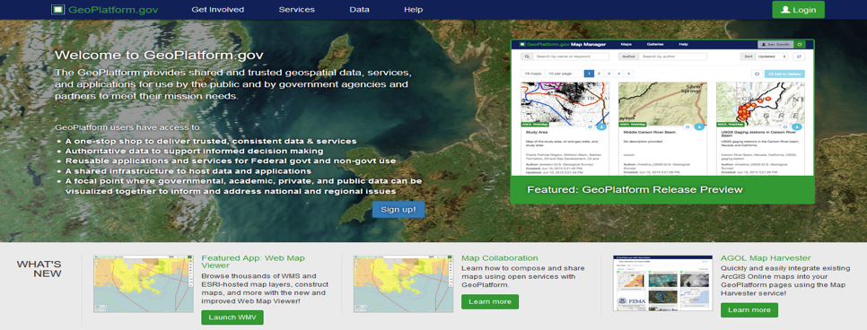
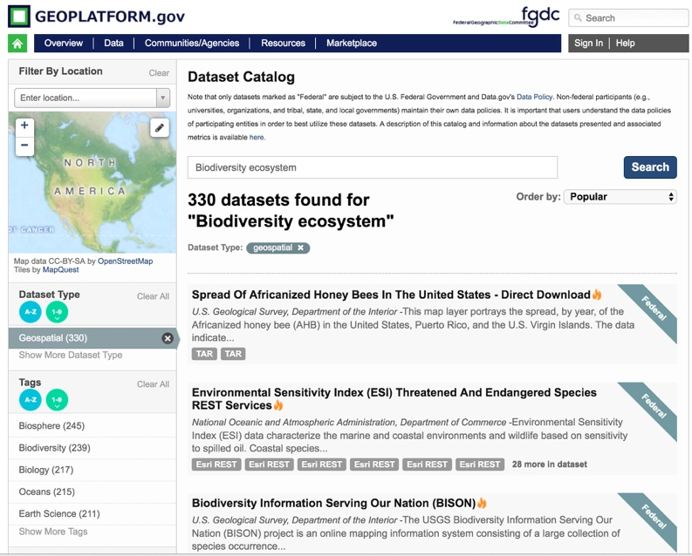
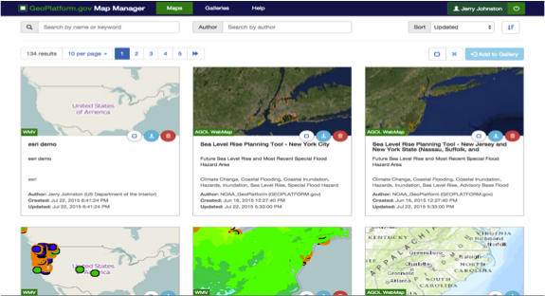
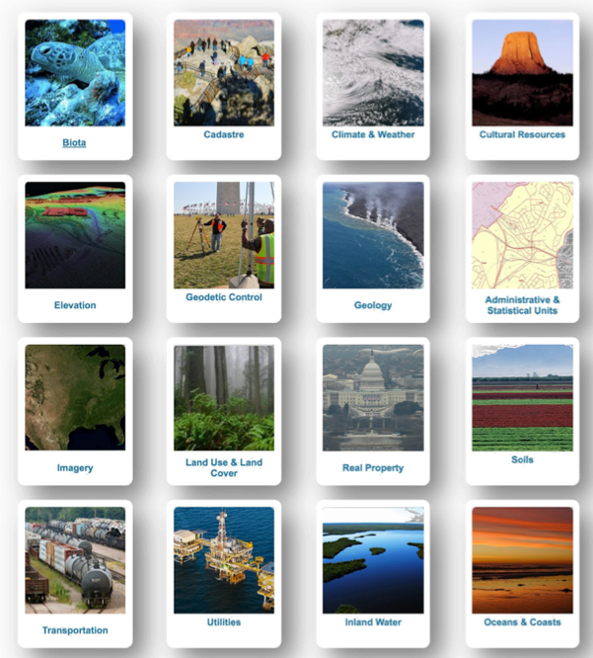
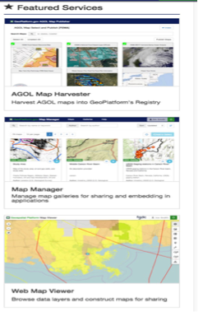
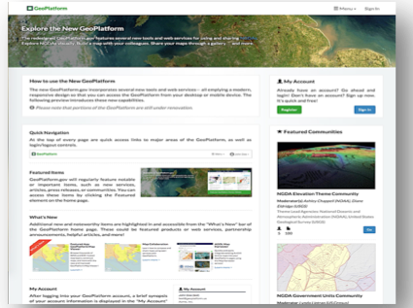
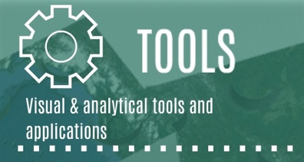
A Spatial Framework for the Location-Based Digital Ecosystem
Geospatial Platform Services
Technology
Tools, Applications
& Services

Slide 19
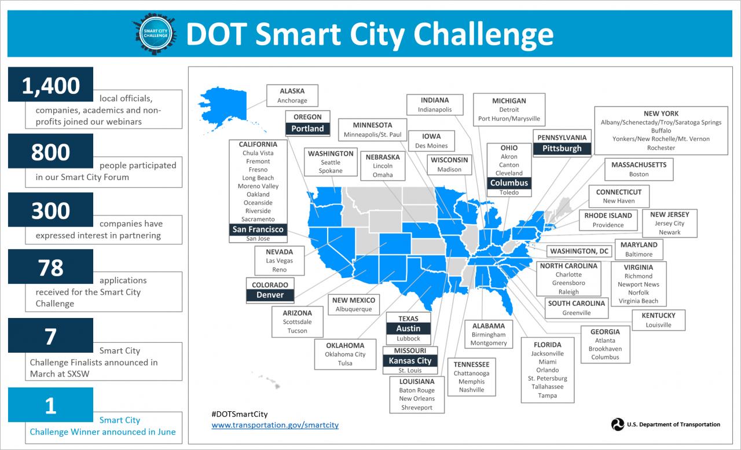
A Spatial Framework for the Location-Based Digital Ecosystem
Public-Private
Partnerships
2016 – $80,000
2016 – $65 Million

Slide 20
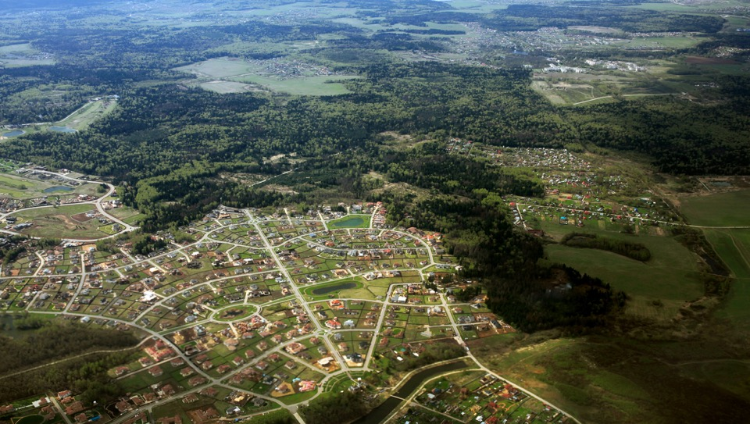
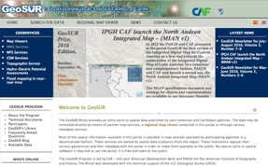
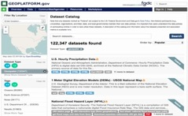
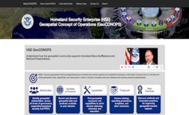
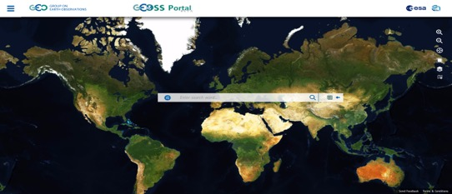
A Spatial Framework for the Location-Based Digital Ecosystem
International Collaboration
ARCTIC SDI
GeoSUR
Regional
GLOBAL Earth Observation System of Systems (GEOSS)
Data Catalog
Tools
Products
Services
Communities
National
Local | State | Tribal | Federal | Academia | Professional
Global
Global
20

Slide 21
A Spatial Framework for the Location-Based Digital Ecosystem
QUESTIONS?
Contact: FGDC@FGDC.gov

