Slide 1
ISO Geospatial Metadata
the
411
on
19115 (-1)
Lynda Wayne, GISP, ASLA
GeoMaxim – Federal Geographic Data Committee (FGDC)

Slide 2
ISO Geospatial Metadata
411
Why ISO?
New Content
Transitioning from CSDGM to ISO
Resources

Slide 3
Why ISO?
Application to range of geo info resource types
datasets
data applications & services
data models, schemas & associated documents
symbology
feature catalogs
Application Tip Document relationships among resource types such as datasets associated with a specific service, e.g. web-mapping application

Slide 4
Why ISO?
Flexibility & customization
few mandatory elements
more robust elements
guidance on building profiles/extensions
Application Tip Skip the irrelevant, go deep where you want, e.g. data processing, make the metadata your own

Slide 5
Why ISO?
Modular and efficient
suite of standards – use what you need
reuse and recombine records
save snippets of commonly used content
use of identifiers to reference related resources
Application Tip Build library of contact, source data, and process step snippets and reference (dynamic ‘href’ link) or incorporate (‘resolve’ the link)

Slide 6
Why ISO?
Standardized content & format
fixed domains - picklists
reference published code lists
UML & XML
Application Tip Use Spatial Reference System Identifiers (SRID) such as EPSG 4269 to reference, vs document, coordinate and projection parameters
Notes:
European Petroleum Survey Group (EPSG) publish a database of coordinate system information

Slide 7
Why ISO?
Standardized content & format
International
and
National
Application Tip International is becoming national. NSDI applications such as GeoPlatform – Data.gov utilize ISO metadata format, ISO Topic Categories, & more. The FGDC plans to endorse 19115-1 and associated standards in 2016.
Notes:
- Use Spatial Reference System Identifiers (SRID) such as EPSG 4269 to reference, vs document, coordinate and projection parameters

Slide 8
New Content
All you favorite CSDGM elements are there, except ‘Baud Rate’, with some additions:
Mandatory – a list of 22 high level subject headings such as: farming, biota, boundaries, economy, elevation, environment, health, imagery, inlandWaters, location, oceans, planningCadastre, society, transportation
Optional – provides context for the data; a description of how the data has been or is currently being used
Topic Category
Specific Usage

Slide 9
New Content
Optional – describe the columnar extent of a data set, especially relevant to atmospheric, oceanic, and geologic data
Optional – describe multiple data spans within the same study, e.g. land loss between 1925-1930 compared to 1955-60 and 1985-90 loss areas
Vertical Extent
Multiple Range of Dates

Slide 10
New Content
Optional – describe the action that happens if the URL is selected, e.g. download, information, email, order, search, browsing, complete Metadata…
Optional – identify multiple individuals and organizations associated with a resource and describe their role, e.g. custodian, originator, distributor, contributor, funder, stakeholder, sponsor…
Online Function Code
Multiple Responsible Parties and Roles

Slide 11
Transitioning: CSDGM to ISO
Now
Edit CSDGM Records
Add ISO Topic Categories as Theme Keywords
As Needed
Transform CSDGM Records to ISO
Use RS/GIS software display as, export as, or transform feature
Use NOAA XSLTs in XML editor http://www.ncddc.noaa.gov/metadata-standards/metadata-xml/
See FGDC Metadata Quick Guide for guidance
Review record carefully, note edits for future transform
As data are used, shared, published

Slide 12
Transitioning: CSDGM to ISO
Make Organizational Change to ISO
Apply and adapt FGDC CSDGM to ISO Model Work Flow
When Able
See FGDC ISO Geospatial Metadata Implementation Forum website ISO Implementation Model Workflow PPT/PDF (July 2014)

Slide 13
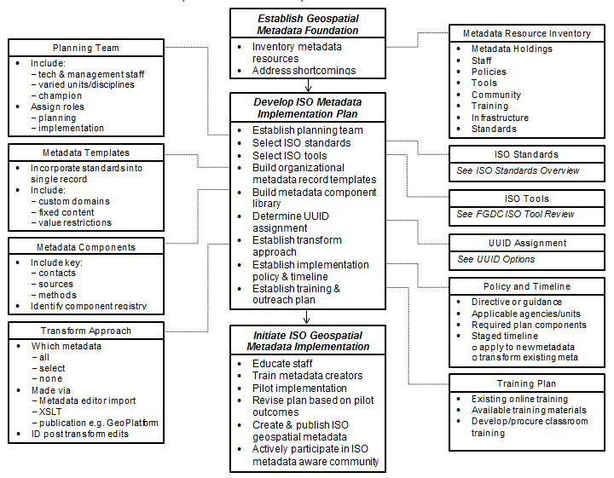
CSDGM to ISO Model Workflow

Slide 14
ISO Geospatial Metadata Resources
FGDC ISO Implementation Forum
FGDC ISO Implementation Webinar Materials
Alternates with quarterly FGDC MWG meetings
Online training provided Federal Metadata Coordinators
Includes introductory information and agency case studies
http://www.fgdc.gov/metadata/events/ISO_Implementation_ Webinar
Monthly Stakeholder presentations & discussions about issues, opportunities, challenges, solutions, applications, etc.
http://www.fgdc.gov/metadata/events/iso-geospatial-metadata-implementation-forum

Slide 15
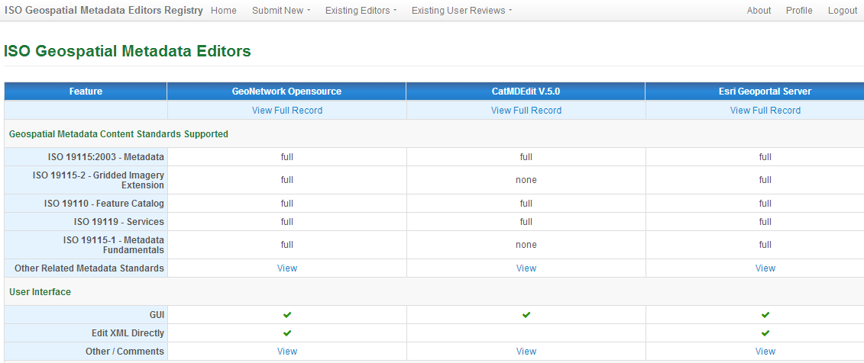
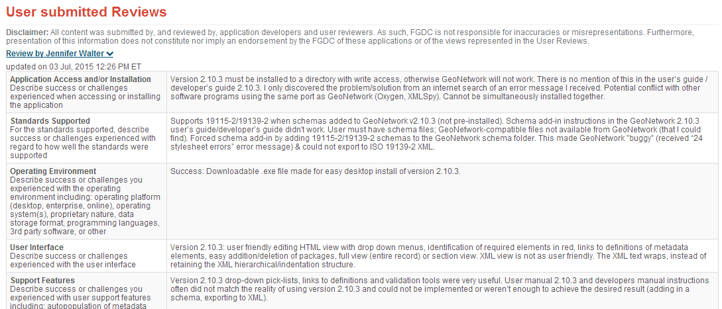
ISO Geospatial Metadata Resources
ISO Geospatial Metadata Editors Registry https://www.fgdc.gov/iso-metadata-editors-registry/editors

Slide 16
ISO Geospatial Metadata Resources
NOAA ISO Metadata Resources
CSDGM to ISO Transforms http://www.ncddc.noaa.gov/metadata-standards/
Webinar Training and Materials http://www.ncddc.noaa.gov/metadata-standards/metadata-training/
ISO Metadata Wiki https://geo-ide.noaa.gov/wiki/index.php?title= Category:ISO_19115

Slide 17
More Information
Lynda Wayne, FGDC Metadata Contract Support Lynda@GeoMaxim.com
Jennifer Carlino, FGDC Metadata Coordinator jcarlino@usgs.gov
FGDC Metadata Working Group (& ISO Implementation Forum) send name & organization w/request to join to fgdc@fgdc.gov

Slide 18
ISO Suite of Geo Meta Standards
19115-1
Fundamentals
Imagery, grid, collection data
19115-2
Services
19119
Entity/ Attributes
19110
Custom Data Conventions
19111 – Coordinate System 19109 – Application Schema (see full list of endorsed standards)
Data Quality
19157

Slide 19
Metadata Beyond Data Discovery
Metadata Functions:
Discovery and Access
Use and Application
Data management
Re-use
Timeliness
Shared content
Work flow
Accountability
And more….
ISO facilitates robust data documentation and active data management – if you dare…

Slide 20
ISO Geospatial Metadata Resources
ISO Geospatial Metadata Forum http://www.fgdc.gov/metadata/events/iso-geospatial-metadata-implementation-forum
ISO Geospatial Metadata Implementation http://www.fgdc.gov/metadata/events/ISO_Implementation_Webinar
FGDC Metadata Quick Guide (w/ISO Topic Category Instructions) https://www.fgdc.gov/metadata/documents/MetadataQuickGuide.pdf
ISO Geospatial Metadata Editors Registry https://www.fgdc.gov/iso-metadata-editors-registry/editors
Join the FGDC Metadata Working Group (MWG) send request to join and name, organization, and business sector (Fed, State, NGO, Private, etc) to FGDC@FGDC.gov
ISO 19115-1:2014 Standard (INCITS publication from ANSI) $133 http://webstore.ansi.org/RecordDetail.aspx?sku=INCITS%2fISO+19115-1%3a2014%5b2014%5d
CSDGM to ISO Transforms http://www.ncddc.noaa.gov/metadata-standards/
Webinar Training and Materials http://www.ncddc.noaa.gov/metadata-standards/metadata-training/
ISO Metadata Wiki https://geo-ide.noaa.gov/wiki/index.php?title=Category:ISO_19115
Contact:
Lynda Wayne, FGDC Metadata Contract Support - Lynda@GeoMaxim.com
Jennifer Carlino, FGDC Metadata Coordinator - jcarlino@usgs.gov
Watch for new and improved FGDC Metadata website http://www.fgdc.gov/metadata/

