Slide 1
Cadastral Subcommittee and BLM Cadastral Related Activities FGDC Update
Don Buhler and Robert Ader
July 2015

Slide 2
Presentation Topics
FGDC Cadastral Subcommittee Activities
BLM Cadastral Related Activities

Slide 3
FGDC Cadastral Subcommittee Activities
Public Land Survey System (PLSS) Data Coordination
The Subcommittee worked with the Lynda Wayne, FGDC Metadata Data Subcommittee, to develop the PLSS data collection metadata report.
This report was passed to the geoplatform through Jerry Johnson. http://www.geoplatform.gov/node/243/84324aed-78c1-4801-99e3-1ac6c00a3a84

Slide 4
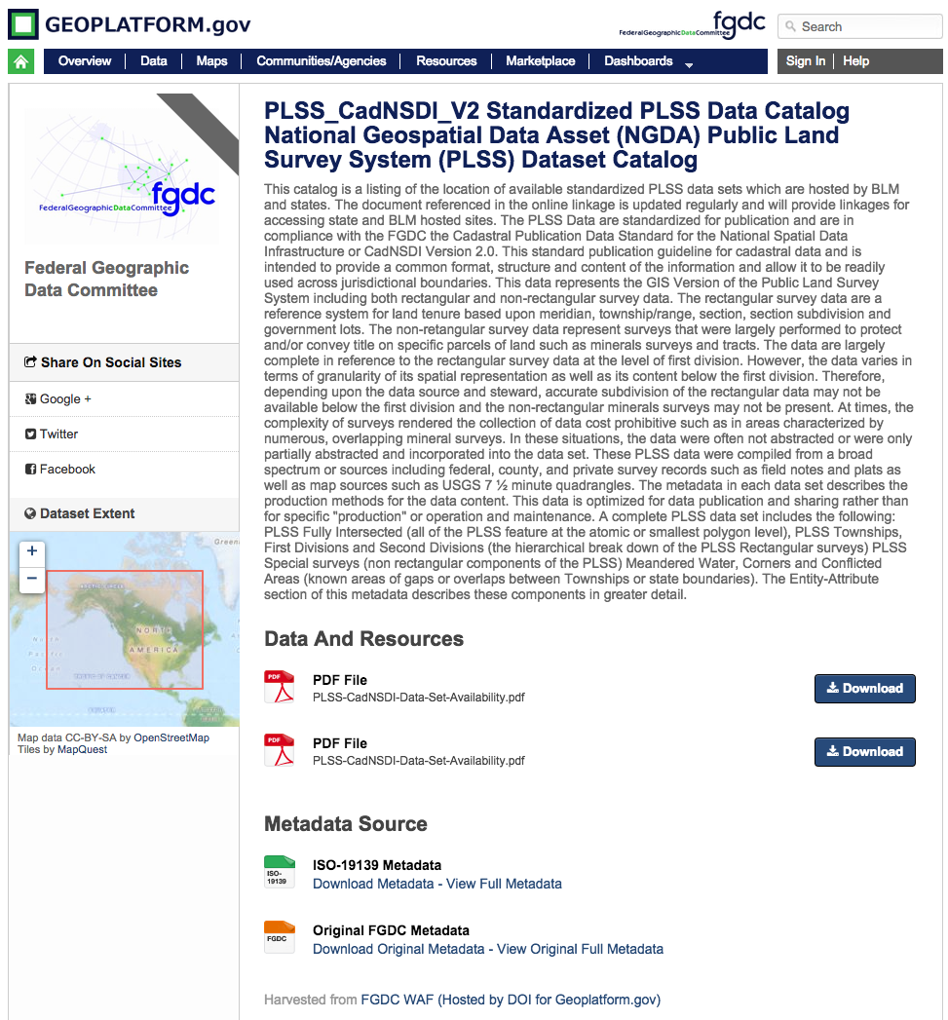

Slide 5
FGDC Cadastral Subcommittee Activities
PLSS Data Coordination
Oklahoma is the only remaining state to be completed – late summer 2015.
This will complete the PLSS National Geospatial Data Asset (NGDA) data set.
Updates are recorded monthly and can be found at
http://nationalcad.org/download/PLSS-CadNSDI-Data-Set-Availability.pdf

Slide 6
FGDC Cadastral Subcommittee Activities
Continued efforts toward a Federal Surface Lands Rights and Interests data set guidelines.
These guidelines would contain sufficient information to support Land Agency decision making.
Support BLM LR2000 record updates.
Lead to more consistency between production databases used by land management agencies.

Slide 7
FGDC Cadastral Subcommittee Activities
Updates to Outreach site nationalcad.org
Outreach site redesigned for responsive viewing (mobile viewing)
Updated documents including adding a permanent link for documents.
Added documentation of standard domains of values for PLSS CadNSDI data sets.
Updated project reports.

Slide 8
BLM Cadastral Related Activities PLSS Data Sets
Standardized all PLSS Data as an NGDA Data Set
This process includes
extracting updates from production and collection
Coordinating with eastern states for best available statewide PLSS data sets
Reviewing and updating standardized attributes for continued improvement in consistency and accuracy

Slide 9
BLM Cadastral Related Activities PLSS Data Sets
Adopted Esri’s Parcel Fabric for the PLSS data set maintenance platform
Nevada, Montana and Arkansas have been imported to the Fabric
Active maintenance in Montana and Nevada
Utah will be the next state
12 states will be migrated in the fall
Other states will be scheduled until all are completed

Slide 10
BLM Cadastral Related Activities Land Buy-Back Program for Tribal Nations
Completing records analysis, boundary updates and reports for Trust Asset and Accounting Management System (TAAMS) updates
This is an outcome from the Cobell law suit settlement.
The buy back is a process to consolidate fractionated interests.
There are over 300 Indian reservations in the US.
In FY 2015 over 80 buy back reservations will be mapped for records improvement, land descriptions, location and appraisals.
In FY 2016 over 153 buy back reservations will be completed.

Slide 11
BLM Cadastral Related Activities Indian Country – Non Buy Back
Working on over 25 non-buy back reservations
In FY 2016 BLM will complete the records improvement and land descriptions for Indian trust parcels on 25 reservations.
Discrepancies will be reported to TAAMS
BIA is the lead for the reservation boundary updates

Slide 12
BLM Cadastral Related Activities Specifications for Land Descriptions
Completed updated version which will be released in the Fall of 2015
For Use in Land Orders, Executive Orders, Proclamations, Federal Register Documents, and Land Description Data Bases
It is more important now than in the past that the person preparing land descriptions be knowledgeable of requirements for the preparation of the various types of land descriptions.
It is necessary to use the proper format, terms and phrases, and intent with qualification to assure the content of the land description is free of ambiguity.
The ambiguous descriptions of the past are the boundary disputes of the future.

Slide 13
2016 Planned Activities
FGDC Cadastral Subcommittee
Coordination with Boundary Working Group - connecting boundary information to cadastral information.
Facilitate state based maintenance of PLSS data sets.
Continued outreach and education on cadastral data coordination and facilitation.
BLM Cadastral
Support Cobell buy back lands records and mapping
Support non-buy back tribal lands records improvement
Federal lands PLSS maintenance implementation with commercially viable software

