Slide 1
FGDC Current Activities
FGDC Steering Committee
September 29, 2016
Ivan DeLoatch
Executive Director
Federal Geographic Data Committee

Slide 2
Topics:
FGDC 2016 Annual Report
2017 NGAC Appointments
2016 Geospatial Platform Workshop
2016 FGDC Meetings Summary
  Federal Parcel Data Workshop

Slide 3

FGDC 2016 Annual Report
“Recognizing Success and Planning for the Future”
Expedited timeframe
Agency, subcommittee, working group content due September 28
Digital (.pdf) version anticipated by mid-December
Printed copies in January

Slide 4
2017 NGAC Appointments
Call for Nominations issued June 2015. Nominations used to fill NGAC vacancies in 2015 and 2016.
Excellent response – many quality applications received.
Interagency review panel has evaluated nominations and developed recommendations.
Final decisions on appointments to be made by Secretary of the Interior’s office.
15 current appointments expire Dec. 31, 2016. New appointments will take effect Jan. 2017.

Slide 5
Current NGAC Membership
Non-Governmental (15) | Governmental (14)
Private Sector (9) Pat Cummens Jack Hild Jeff Lovin Kevin Pomfret Sarah Battersby Matthew Gentile Roger Mitchell Rebecca Moore Carl Reed | State (5) Bert Granberg* Gen. William Reddel III Anthony Spicci* Gary Thompson * Harvey Thorleifson
 | County (1) Jason Warzinik
Academia (4) Joanne Gabrynowicz* Julie Sweetkind-Singer Laxmi Ramasubramanian May Yuan | Federal (2) David Alexander Frank Avila
 | Regional (2) Molly Vogt* Xavier Irias
Non-Profit (2) Keith Masback Douglas Richardson | City/Municipal (1) Amber Reynolds
 | Tribal (2) David Wyatt* Frank Harjo
 | Emergency Services (1) Talbot Brooks
Current Members
(Terms expire December 2016)
Current Members
(Terms expire December 2018)
* Members completing second term on NGAC in December 2016. Per the NGAC Charter, cannot be appointed to third consecutive term.
September 2016

Slide 6
2016 Geospatial Platform Workshop
December 7-8, 2016 at USGS in Reston, VA
DOI in conjunction with FGDC and the National Geospatial-Intelligence Agency (NGA)
Present the implementation of the Geospatial Platform
Share functionality capabilities to the community of data stewards who produce and use governmental, academic, private, and public data to inform national and regional issues
Present approaches underway in GeoPlatform to improve awareness of and access to geospatial data
Discuss future development of the GeoPlatform and collaborative efforts with academia and other web-based data sharing capabilities

Slide 7
2016 Geospatial Platform Workshop - Objectives
Enhance information sharing capabilities of the Federal Government by encouraging dynamic geospatial data sharing through web-service capabilities facilitated and promoted by the GeoPlatform
Provide training on how to access, use, analyze, and share geospatial data through the GeoPlatform
Enable community feedback to identify improvements for the GeoPlatform
Registration: http//wwhgd.org

Slide 8
2016 FGDC Meetings Summary
Steering Committee:
  September 28, 2016, DOI South Interior Building
  December 2016 – in planning
Executive Committee:
  September 22, 2016 – discussion on NSDI Strategic Planning
  October 27, 2016 – FGDC business, Strategic Planning and transition
NGAC:
  September 27-28, 2016, Shepherdstown, WV
  December 2016 (TBD) – Approval of 2016 papers

Slide 9

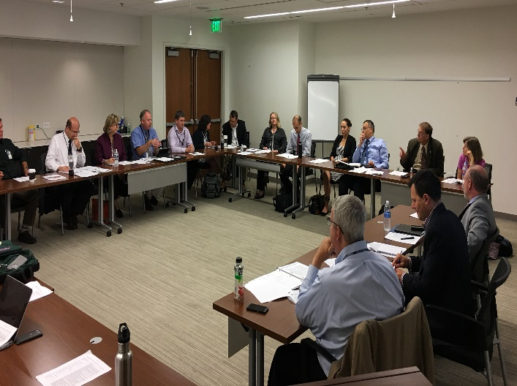

Federal Parcel Data Workshop
Held September 20th at Homeland Security Acquisition Institute (HSAI) with 31 participants across 14 Departments /Agencies
Examined existing Federal use cases for National Parcel Data & any current driving policy mandates
Discussed needed attributes and touch points to other NSDI initiatives (i.e. NAD)
Action Items:
  Will be building a consolidated ‘matrix’ of requirements for both the geometry and business attributes needed by Depts./Agencies.
  Will provide requirements matrix to the FGDC Cadastral Subcommittee and/or other FGDC Governance bodies for review and adjudication.

Slide 10
Questions?

