Slide 1
NSRS Modernization Update
Latitude/Longitude Standards
NADCON 5 agreement
Dru Smith
NSRS Modernization Manager
NOAA’s National Geodetic Survey

Slide 2
NSRS Modernization Update

Slide 3
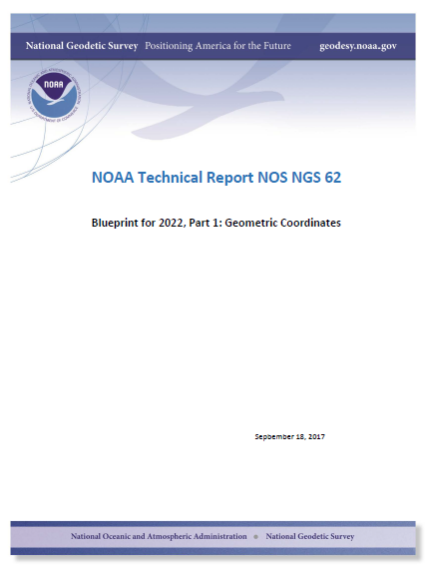
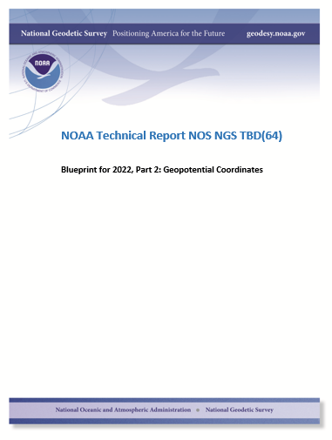
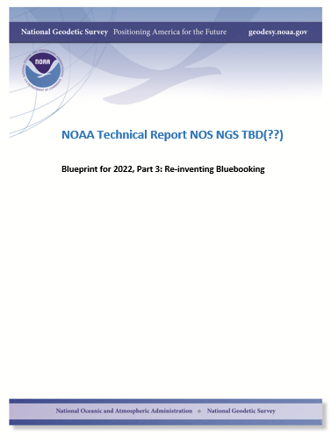
Modernizing the NSRS
The “blueprint” documents: Your best source for information
Geometric:
May 2017
(minor update Sep 2017)
Geopotential:
Planned: Oct 2017
Bluebooking:
Apr(?) 2018

Slide 4
Replacing the NAD 83’s
The Old:
NAD 83(2011)
NAD 83(PA11)
NAD 83(MA11)
The New:
The North American Terrestrial Reference Frame of 2022
(NATRF2022)
The Caribbean Terrestrial Reference Frame of 2022
(CATRF2022)
The Pacific Terrestrial Reference Frame of 2022
(PATRF2022)
The Mariana Terrestrial Reference Frame of 2022
(MATRF2022)

Slide 5
The TRFs
All are global frames (no “boundary”)
This was true for the NAD 83’s also, BTW
But each frame will rotate with one tectonic plate
Put another way: “The frame rotates so your coordinates don’t have to”
All will have an Intra-Frame Velocity Model
To capture any motions outside of tectonic rotation
Residual horizontal motions
All vertical (ellipsoid height) motions

Slide 6
The relation of five global reference
frames through time.
NATRF2022
MATRF2022
Rotations are not to scale
CATRF2022
Rotation of North American Plate
PATRF2022
Rotation of Pacific Plate
IGS frame
IGS frame through time
IGS frame
Rotation of Caribbean Plate
PATRF2022
CATRF2022
Rotation of Mariana Plate
NATRF2022
Time “t ” when
all four TRFs and the
IGS are identical.
(maybe 2020.0?)
MATRF2022
0
t=t - Δt
(“the past”)
t=t + Δt
(“the future”)
0
0

Slide 7
What does it mean to provide time-dependent coordinates in 5 frames?

Slide 8
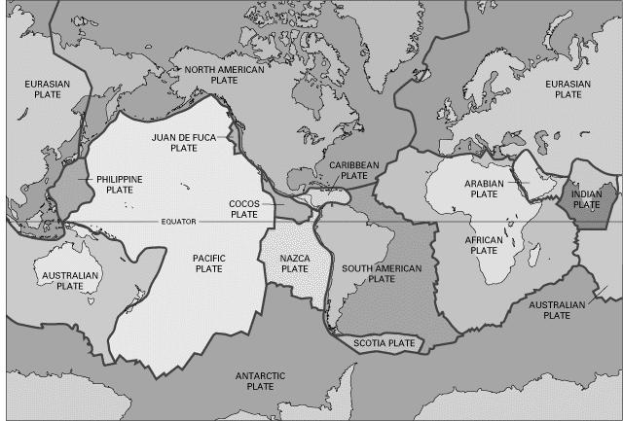
BSMK (North Dakota)

Slide 9
BSMK (North Dakota)
Let’s set t to 2005.0 for now…
Note the time-dependent coordinate in latitude in NATRF2022 is stable! That means the NATRF2022 IFVM for latitude will be ZERO for this point.
0

Slide 10
BSMK (North Dakota)
Similarly, the time-dependent coordinate in longitude in NATRF2022 is stable! That means the NATRF2022 IFVM for longitude will be ZERO for this point.

Slide 11
BSMK (North Dakota)
However, in every frame, this point is subsiding! That will be captured in the ellipsoid height component of the IFVM for each frame.

Slide 12
ICT2 (Kansas)

Slide 13
ICT2 (Kansas)
Note the time-dependent movement of this Kansas point in latitude in NATRF2022! Such movement will be captured in the IFVM.

Slide 14
ICT2 (Kansas)
However, in longitude, this CORS is fairly stable in NATRF2022! Still, any deviation from stability would be in the IFVM.

Slide 15
ICT2 (Kansas)
All vertical motion is captured in the IFVM.

Slide 16
PIN1 (S. California)

Slide 17
PIN1 (S. California)
In latitude, S. California neither behaves like the NA plate nor the Pacific plate. Both deviations from stability will be captured in each frame’s IFVM.

Slide 18
PIN1 (S. California)
In longitude, S. California neither behaves like the NA plate nor the Pacific plate. Both deviations from stability will be captured in each frame’s IFVM.

Slide 19
PIN1 (S. California)
In ellipsoid height, all frames are equal and the entire signal is captured in the IFVM.

Slide 20
Additional examples will be presented at the end if time allows

Slide 21
Intra-frame velocity model
Shown on this slide are CORS-implied velocities after removing the rotation of the
North American plate. NATRF2022 coordinates will change through time by these
amounts. These time-dependent changes will be captured in the IFVM.
Note scale difference between West (10 mm/yr) and east (2 mm/yr)

Slide 22
A simple IFVM model is applied…
The simplest IFVM is already available: Interpolation of 3-D velocities from CORS stations
Removing this simple IFVM resolves nearly all velocities seen in the previous slide
Eastern CONUS will largely be resolved
Western CONUS has some anomalies
NGS is engaged in research to provide the highest quality IFVM without our abilities, possibly enveloping:
InSAR
Geodynamic

Slide 23
Latitude / Longitude Standards

Slide 24
FGCS and standardized lat/lon
Centuries of this history of longitude:
“So many degrees east(west) of Greenwich”
Requires either:
Hemisphere identifier
A “sign” (+/-)
Makes simple computations across the international date line difficult
But either the date line or Greenwich must be the “difficult meridian”

Slide 25
FGCS and standardized lat/lon
Because the USA has territory which crosses the date line (Aleutians) but not Greenwich, I argue that it is better to adopt a system in the USA which makes “Greenwich the difficult meridian”
“The difficult meridian” is where numbers, hemispheres or signs don’t flow smoothly from one side of the meridian to the other

Slide 26
FGCS and standardized lat/lon
1. East/West Alphanumeric (strict)
Crossing the date line: 179E, 180E =180W, 179W
179, 180, 179
Crossing Greenwich: 1W, 0W = 0E, 1E
1, 0, 1

Slide 27
FGCS and standardized lat/lon
2. East/West Alphanumeric (loose=NON UNIQUE SYTEM)
Crossing the date line: 181W, 180W =180W, 179W (181, 180, 179)
Crossing the date line: 179E, 180E, 181E (179, 180, 181)
Crossing the date line: 179E, 180, 179W (179, 180, 179)
Crossing Greenwich: 1W, 0W, 359W (1, 0, 359)
Crossing Greenwich: 359E, 0, 1E (359, 0, 1)
Crossing Greenwich: 1W, 0, 1E (1, 0, 1)

Slide 28
FGCS and standardized lat/lon
3. East/West Numeric (strict)
Crossing the date line: +179, +180 = -180 , -179
+179 , 180 , -179
Crossing Greenwich: -1 , 0 , +1
-1, 0, +1

Slide 29
FGCS and standardized lat/lon
4. East/West Numeric (loose=NON UNIQUE SYTEM)
Crossing the date line: -181, -180, -179
Crossing the date line: 179, 180, 181
Crossing the date line: +179, 180, -179
Crossing Greenwich: -1, 0, +1
Crossing Greenwich: 359, 0, 1
Crossing Greenwich: -1, 0, -359

Slide 30
FGCS and standardized lat/lon
5. Positive East Numeric (strict)
Crossing the date line: +179, +180, +181
Crossing Greenwich: +359, 0, +1

Slide 31
Is there a need for standardization?
Data exchanges
Integrated databases
Overlapping products and services

Slide 32
NADCON 5 Agreement

Slide 33
FGCS and FRNs
In 1990, then-FGCC issued FRN setting “NADCON” as the standard method of mathematically transforming from NAD 27 to NAD 83
Never updated for new versions of NADCON
Never updated for other datums
Never updated for other realizations
Never updated for GEOCON
No such “VERTCON” FRN was ever issued

Slide 34
FGCS and FRNs
Recommendation:
FGCS revitalize the process of using the FRN to standardize datum transformation software
Specify version number?
A new FRN for every update?
Don’t generalize for datum or datum transformation
A new FRN when a new datum/realization has a supported tool
Such as in 2022 when the four TRFs are released

Slide 35
FGCS and FRNs
As of today:
NADCON is in version 5.0
Supports a specific list of “horizontal datums” and/or “geometric reference frames”
I am proposing that the FGCS issue an FRN standardizing NADCON v.50 as the chosen method to transform between specific datums
And that as new tools come available, we continue the trend

